Slide 1
A “Sure Fire” Way to Ensure Schedule Performance!
Mark Hehl
www.hehlassociates.com
mhehl@charter.net
203 982 6231

Slide 2
Agenda
The Schedule Squeeze
  “Parkinson’s Law”
Improving Schedule Performance
The Key Improvement Tool
Using Process Mapping to maintain and reduce scheduled tasks
Implementing Improvements
Identifying Processes to map
Getting Started

Slide 3
Parkinson’s Law
“The time required to perform a task will automatically expand to fill the time allotted for it”.

Slide 4
“I will give you anything but more time”
Most schedules fall behind
  Unrealistic
  Resources
  Unanticipated events
  Delays
  Negative consequences

Slide 5

The Schedule Challenge
Challenging - Realistic
  Motivation issue
History Repeats Itself
  Consistent areas / tasks / causes

Slide 6
The Reactions Do Not Need To Be Negative!
Schedule slippage added cost
  Cutting corners risk increase
Additional resources added cost
  People
  Time
Problem area/s process improvement
  No added cost
  No risk increase

Slide 7
A Positive Reaction - Process Improvement
Identify areas / tasks that typically cause schedule problems
  Most cases - problem is with a few processes
Understand the process
Analyze the process
Identify improvements
Implement improvements
Control / follow up

Slide 8
The First Step Towards Improvement - Process Mapping
-Visually depicts the sequence of events to build a product or produce an outcome.
1) understand the process
2) Analyze
3) Improve

Slide 9
Process Map
A defined graphical representation of a process showing the:
  Steps of the process
  Time & Cost
  Inputs and outputs for each step
  Suppliers and customers
  Media used
  Issues in present process

Slide 10
Process Mapping Sessions Capture
Non-value added activities
Delay points in the process
Cumbersome forms
Lack of supporting documentation and information
Lack of understanding
Inconsistency

Slide 11
“Quick Wins” - Value Added vs. Non-Value Added
Within an average American organization, less than 25% of the company’s time and effort is spent on value-added activities.
More than 60% is spent on activities that consume time and create cost without creating any value.

Slide 12
Proceeding with Process Mapping
Group activity
  Individuals performing the activity
  True experts
“as is” map
Cards attached to wall
  Elapsed time
  Labor hours
  Cost
  Defects

Slide 13
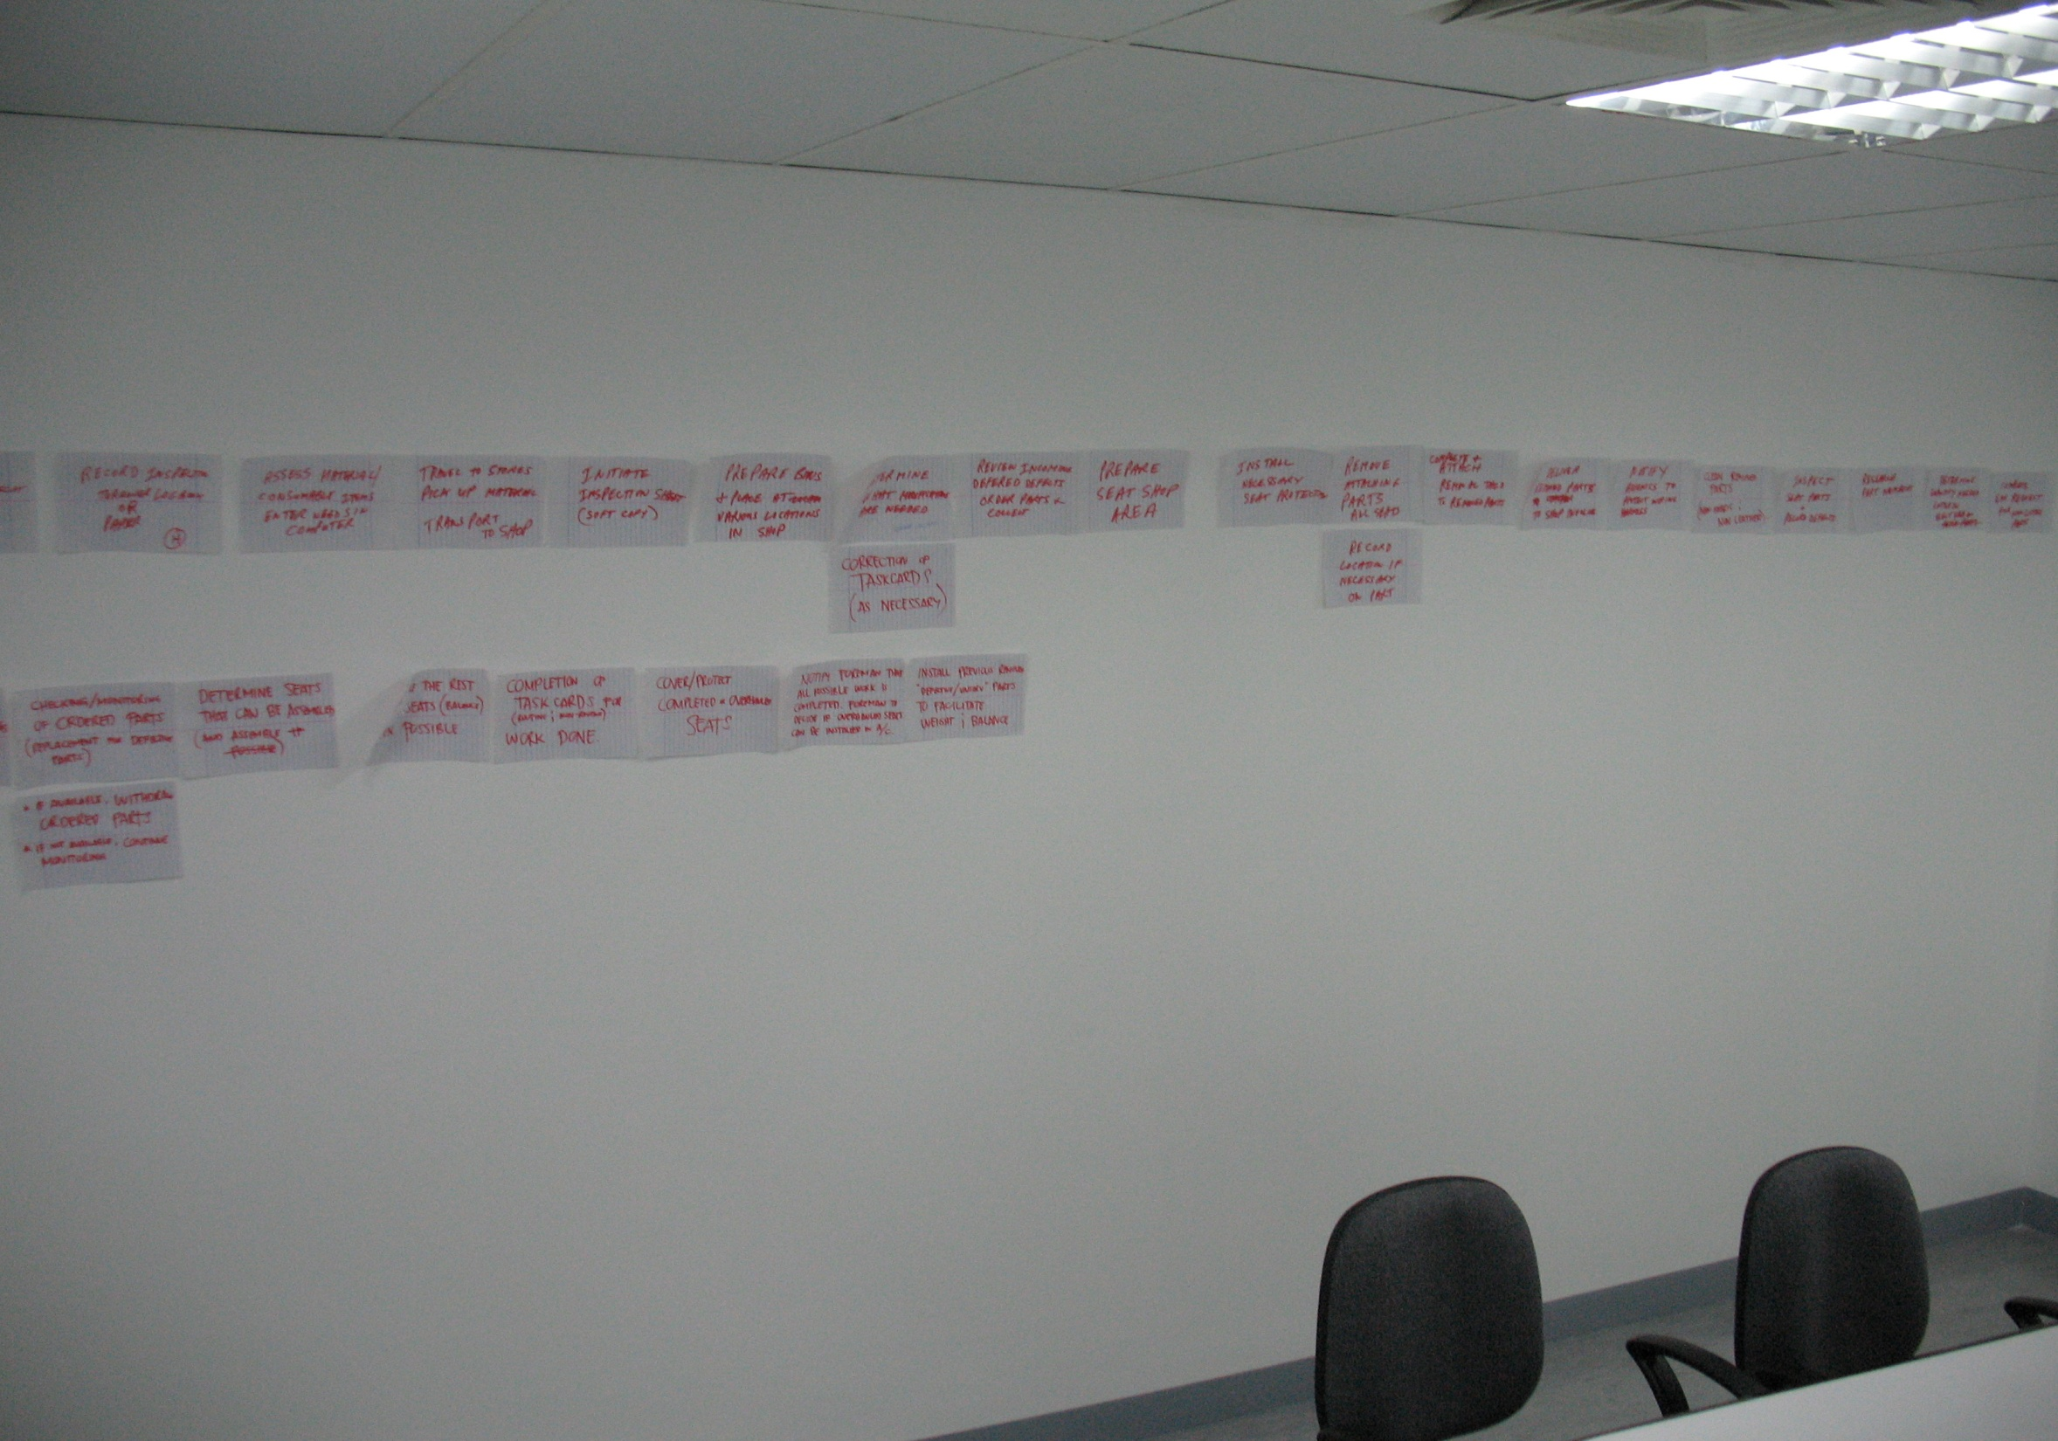
Example
Add photo of a process map in process,
Index cards on wall

Slide 14
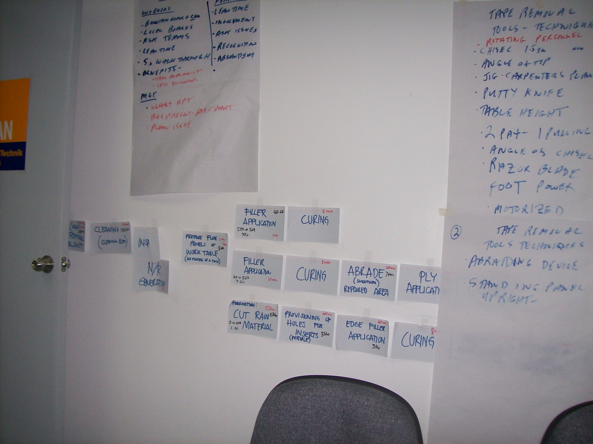

Slide 15
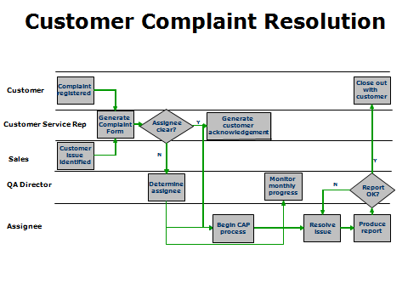
Swimlane - Process Map

Slide 16
$4 Million Annual Savings
Unintentional outcome (Quick Win)
New customer orders
Dual inventory assessments
Duplicate ordering of expensive material
Results
  Reduce inventory
  Faster process time
  Increased space for actual work
  8 extra hours/week available for preventative work

Slide 17
Achieving Results
Analyze each step
Select significant steps
Improve
Implement
Measure results

Slide 18
Schedule Improvement - Getting Started
Team
  Those involved – the real experts!
Facilitator
  Trained
  Experienced
Room with available walls
Large Index Cards

Slide 19
You Must Have a Trained Facilitator
A trained & experienced facilitator is a requirement
Most common reason for failure!
  Inadequate facilitation skill

Slide 20
Benefits
Increases speed
  – Schedule Compliance
Lowers cost
Improves quality
Enhances productivity
Allows the workforce to contribute
  Motivation
  Buy-in
  Teamwork

Slide 21
Questions?
Thank you for allowing me to be of service!
Mark Hehl
www.hehlassociates.com
203 982 6231
Mhehl@charter.net

