Slide 1
A Tale of 2 Projects
Hopkins Unit 2 Repowering
Thomas P. Smith AWT Project
Project Management Institute
Tallahassee Florida Chapter
December 3, 2012

Slide 2
Agenda
Introductions
Project Descriptions
  Hopkins Unit 2 Repowering Project
  Thomas P. Smith Advanced Wastewater Treatment (AWT) Project
Contracting Strategies
Outcomes and Lessons Learned
Questions

Slide 3
Introduction – Rob McGarrah
32 years of experience in electric utilities
  21 years with City of Tallahassee – Electric
  11 years with Mississippi Power Company, Southern Company
BS in Mechanical Engineering from Auburn University
Currently the General Manager for the City’s Electric Utility
  Also serving as the Project Director for AWT Project for the City’s Underground Utilities
Since joining the City – has managed four major projects totaling over $500 million
  Purdom Unit 8 - $107 M
  Peaking Resource Addition - $61 M
  Hopkins Unit 2 Repowering - $144 M
  AWT Project - $227 M

Slide 4
Introduction – Jim Oskowis
39 years of experience in public water and wastewater utilities
24 years with City Water & Sewer and Underground Utilities
M.S. in Environmental Engineering from the University of Arkansas
Registered Professional Engineer in Florida
Former General Manager of City Water & Sewer Utility for 7.5 yrs.
Assistant GM for re-organized Underground Utilities since 2008
Current Primary Responsibility is City Site/Construction Manager for AWT Improvements Project

Slide 5
Tallahassee Electric Utility
Named #1 Public Utility by American Public Power Association in 2012
3rd largest municipal electric utility in Florida¹
25th largest municipal electric utility out of 2000 in United States¹
816 MW of generation and purchased power
194 miles of 115/230 kv transmission
2,870 miles of distribution
298 Employees
1 – 2010 APPA by customers

Slide 6
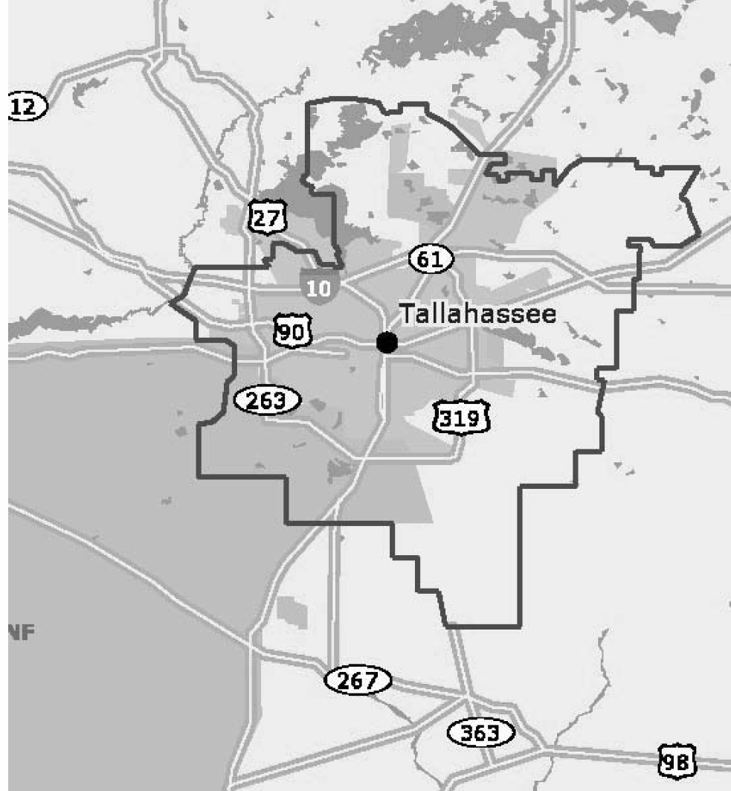
Electric Service Territory
221 square mile service territory
  Includes portions of the unincorporated area of the County
114,000 customers

Slide 7
Tallahassee Underground Utility
Comprised of Water, Wastewater, Gas and Stormwater
Customers
  Water – 82,520 customers including unincorporated areas in Leon County and extending to St. Marks in Wakulla County
  Wastewater – 69,500 customers including unincorporated areas in Leon County
  Gas – 28,000 customers including in City, and Leon, Wakulla, and Gadsden Counties
  Stormwater – Responsibility within City Limits

Slide 8
Tale of 2 Projects
Both Projects were Major Construction Activities
  2 largest projects in City’s history ($ based)
Both Projects were fast tracked
  Completed much quicker than “standard”
Both Projects Required Existing Facilities to Remain in Operation
Both Projects relied significantly on In-House staff
  Did not increase City permanent staff to support projects
    Relied on limited contract and temporary staff to support field QA/QC activities
  Most assigned City Employees wore two Hats
    Regular Job and Project Responsibilities

Slide 9
Hopkins Unit 2 Repowering

Slide 10
Hopkins Unit 2
235 MW conventional Steam Generating Unit
  Natural Gas
  #6 Fuel Oil
Original Commercial Operations – 1977
Generating Heat Rate (Efficiency) – 10,500 btu/kwh
Base Load Operations

Slide 11
Conventional Steam
Steam Turbine/Generator
Steam
Generator
Boiler
Fuel

Slide 12
HP2 Repowering
Convert from Conventional Steam to Combined Cycle
Provided for ~30% Efficiency Improvement
  Generating Heat Rate (Efficiency) – 7,600 btu/kwh
  $12-24M annual savings in fuel cost
Increased Output from 235 MW to 300 MW (summer)
Reduced Environmental Emissions
Original Project Budget - $156 M
  Final Cost - $144 M
    Permitting and City Costs - $5 M
    Engineering - $10 M
    Equipment - $55 M
    Construction - $71 M

Slide 13
Combined Cycle
Steam Turbine/Generator
Steam
Heat Recovery Steam Generator
Generator
Combustion Turbine/Generator
Generator
Exhaust Gases
Fuel

Slide 14
Repowering Timeline
2004/2005 time frame
  Natural Gas prices on the increase
    Generating Efficiency Key
  Integrated Resource Planning (IRP) process underway
    HP2 Repowering had been identified as a resource in the 2010/2012 timeframe
    HP2 Repowering had been identified in the top resource plans
  Fall of 2005 – City Commission asked how quickly project could be done
    June 2008 was identified as “best case” commercial operations date
    Would require “non-traditional” actions to be taken by City to meet this date
  October 2005 – City Commission Approved Project
    Traditional Design – Bid – Build concept
October 2005 – Engineering & Permitting Commenced

Slide 15
Timeline - Continued
2006 – Purchase of Major Long Lead Time items
  25 Different Contracts
November 2006 – Permits Issued
  Commenced Piling Installation
January 2007 – Awarded General Contractor Contract
March 2007 – GWC Mobilized
Unit outages
  Spring 2007
  Fall 2007
  Spring 2008
June 2008 – Commercial Operations

Slide 16
HP2 Repowering Project Team

Slide 17
Thomas P Smith
Advanced Wastewater Treatment (AWT)
Project

Slide 18
Thomas P Smith Facility
Originally Constructed in 1965 @ 2.5 million gallons per day (mgd)
  Expanded in 1973, 1983, and 1991 to reach current capacity
Older Treatment Technology
  Different technologies depending on phase of facility
Treatment Capacity
  Original – 27.5 MGD
  Post AWT – 26.5 MGD

Slide 19
AWT Project
Upgrade to State of the Art Treatment Facility
  BNR Technology
  Reduced Total Nitrogen from ~14 mg/l to 3.0 mg/l
  100% of bio-solids to be Class 1 (fertilizer)
Project Budget - $227 M
Phased to Allow for Continued Operation/Target Permit Milestones
  Phase 1 – Liquids
  Phase 2 – Solids
  Phase 3 – BNR Conversion

Slide 20
AWT Project Drivers
Schedule Driven by Permit Conditions
  2004 – Submitted Permit Renewal Application
  February 2006 – FDEP Notices Intent to Issue Permit
  March 2006 – Petitions for Intervention Filed
    Joe Glisson, Individual
    Florida Wildlife Federation
    Wakulla County
    Florida Attorney General
  December 2006 – Settlement Agreement
  January 2008 – FDEP Issues Final Permits

Slide 21
Original Permit Compliance Timeline
Effluent Nitrogen
< 12 mg/L
Effluent Nitrogen
< 9 mg/L
New Bio-solids Facility
Effluent Nitrogen
< 6.5 mg/L
Effluent Nitrogen
< 3 mg/L
1st Treatment Train Upgraded to AWT
2nd Treatment Train Upgraded to AWT
3rd Treatment Train Upgraded to AWT
2008 | 2009 | 2010 | 2011 | 2012 | 2013 | 2014

Slide 22
AWT Project Drivers - Continued
Had to Maintain Operations to meet City Customer Needs
Had to Meet Strict Compliance and Construction Timeline
Required Engineering and Construction to be performed Simultaneous

Slide 23
AWT Project Team

Slide 24
Contracting Strategies

Slide 25
Contracting Components
Component | HP2 Repowering | AWT
Permitting | City with Engineering and Legal Assistance | City with Engineering and Legal Assistance
Engineering Design | Sargent & Lundy | Hazen and Sawyer
Equipment Procurement | City | Contractor
Constructor | BE&K Construction | MWH Constructors
Contract Type | Hybrid | CMAR
Construction Crews | Direct Hire | Sub-Contractors

Slide 26
HP2 Repowering GWC Contract
3 Phase Competition
  Phases 1 & 2 – Pre-qualification
  Phase 3 – Technical & Commercial Proposals
BE&K Constructors Won Competition
  Construction primarily by direct hire BE&K staff
Hybrid Contract – Partial Fixed and Partial Floating
  Fee and Overheads - Fixed
  Materials and Sub-Contractors – Direct Pass Through
  GWC Labor – Pass Through with Incentives

Slide 27
Repowering – Hybrid Contract - Why
Market Constraints
  Katrina/Rita aftermath
  Other Major Projects
  Tight Labor Market
    Projects
    Lack of In-Flow of Qualified Craft
Commodity Costs Fluctuating
Fixed Price
  Higher Risk Premium by Contractors
  Limited, if any, Takers

Slide 28
Repowering – Fixed Fee
~$18 Million
Included
  Fee
  Risk Costs
  Home Office Support
  Temporary Construction Office and Equipment
  Field Supervision down to Superintendent Level
Could Only be Adjusted Based on Schedule Overruns

Slide 29
Repowering – Material & Sub Contractors
~$27 Million
Included
  All Materials/Equipment not supplied by City
    Bulk materials mainly
  All Sub-Contractor services
    Insulation
    X-Ray
    Fire Protection
BE&K Performed Competitive Bids
  City reviewed and approved

Slide 30
Repowering – Construction Labor
~$20 Million
Included
  Field Supervision not included in Fixed Fee
  Field Craft Labor
    Direct hires
Established Target Man-hours with Base Proposal
  Adjusted Target MH based on scope adjustments
    Differences in bulk quantities, etc.
  Shared Savings/Costs if Target Missed

Slide 31
Repowering - Target Man-Hour Sharing
Under
Target Man-hours
Over
>-20%
-12.5% to -20%
-5% to –12.5%
-5% to +5 %
+5% +12.5%
+12.5% to +20%
>+20%
100%
Contractor
25% City
75% Contractor
50% City
50% Contractor
No Change
50% City
50% Contractor
25% City
75% Contractor
100%
Contractor

Slide 32
AWT Contract
Construction Manager at Risk Concept (CMAR)
  Needed due to tight timeline
  Desire to have constructor involved in final design
MWH Constructors selected as CMAR through a Competitive Process
CMAR Contract components
  General Conditions – Fixed
  Equipment – Pass Through
  Construction – Utilized Sub-Contractors with direct pass through
Each Phase had separate contract
  Modified CMAR contracting Process prior to major constructing starting

Slide 33
Modified CMAR Contract
Component | Original CMAR | Modified CMAR
General Conditions | Negotiated and Fixed | Negotiated and Fixed
Materials/Equipment | CMAR Bid and estimated | CMAR Bid and Fixed
Construction | CMAR Bid and estimated | CMAR Bid and Fixed except for scope change
Contingency | Set in CMAR Contract with CMAR managing | City Managed – Change order to CMAR for scope changes

Slide 34
Repowering – General Conditions
Fixed for each Phase
Included
  Fee
  Risk Costs
  Home Office Support
  Temporary Construction Office and Equipment
  Field Supervision of Sub Contractors
  Competitive Bidding Costs
Negotiated for Each Phase
  Based on schedule duration
  Coordinated between Phases

Slide 35
AWT – Material & Equipment
Included all Materials/Equipment
MWH Competitively Bid prior to Phase Contract being Approved
  City and Hazen reviewed prior to selection
Fixed Price once Phase Contract was Executed
  Scope Changes required Change Orders

Slide 36
AWT – Construction
Included all Construction activities
MWH Performed
  Construction Management & Coordination
  Quality Assurance/Control
  Schedule Oversight
Utilized Sub-Contracts for all Construction
MWH Competitively Bid prior to Phase Contract being Approved
  City and Hazen reviewed prior to selection
Fixed Price once Phase Contract was Executed
  Scope Changes required Change Orders

Slide 37
Outcomes
Components | HP2 Repowering | AWT Project
Schedule | Met CO Date | Ahead of Environmental Milestones On Schedule to meet construction targets
Cost | Under budget | On Budget
Quality | Met all performance standards | Meeting or beating all performance standards
Safety | No Lost time Accidents Minor Medical Case Accidents | No Lost Time Accidents Minor Medical Case Accidents

Slide 38
Lessons Learned
No One Size Fits All solution
  Need to modify with project and situation
Build on Prior Project Successes
Despite Government Reputation – We can and do
  Meet Schedules
  Meet Budgets
  Meet Performance

Slide 39
Questions

