Slide 1

Scrum Overview

Slide 2

The Agile Practice

Slide 3
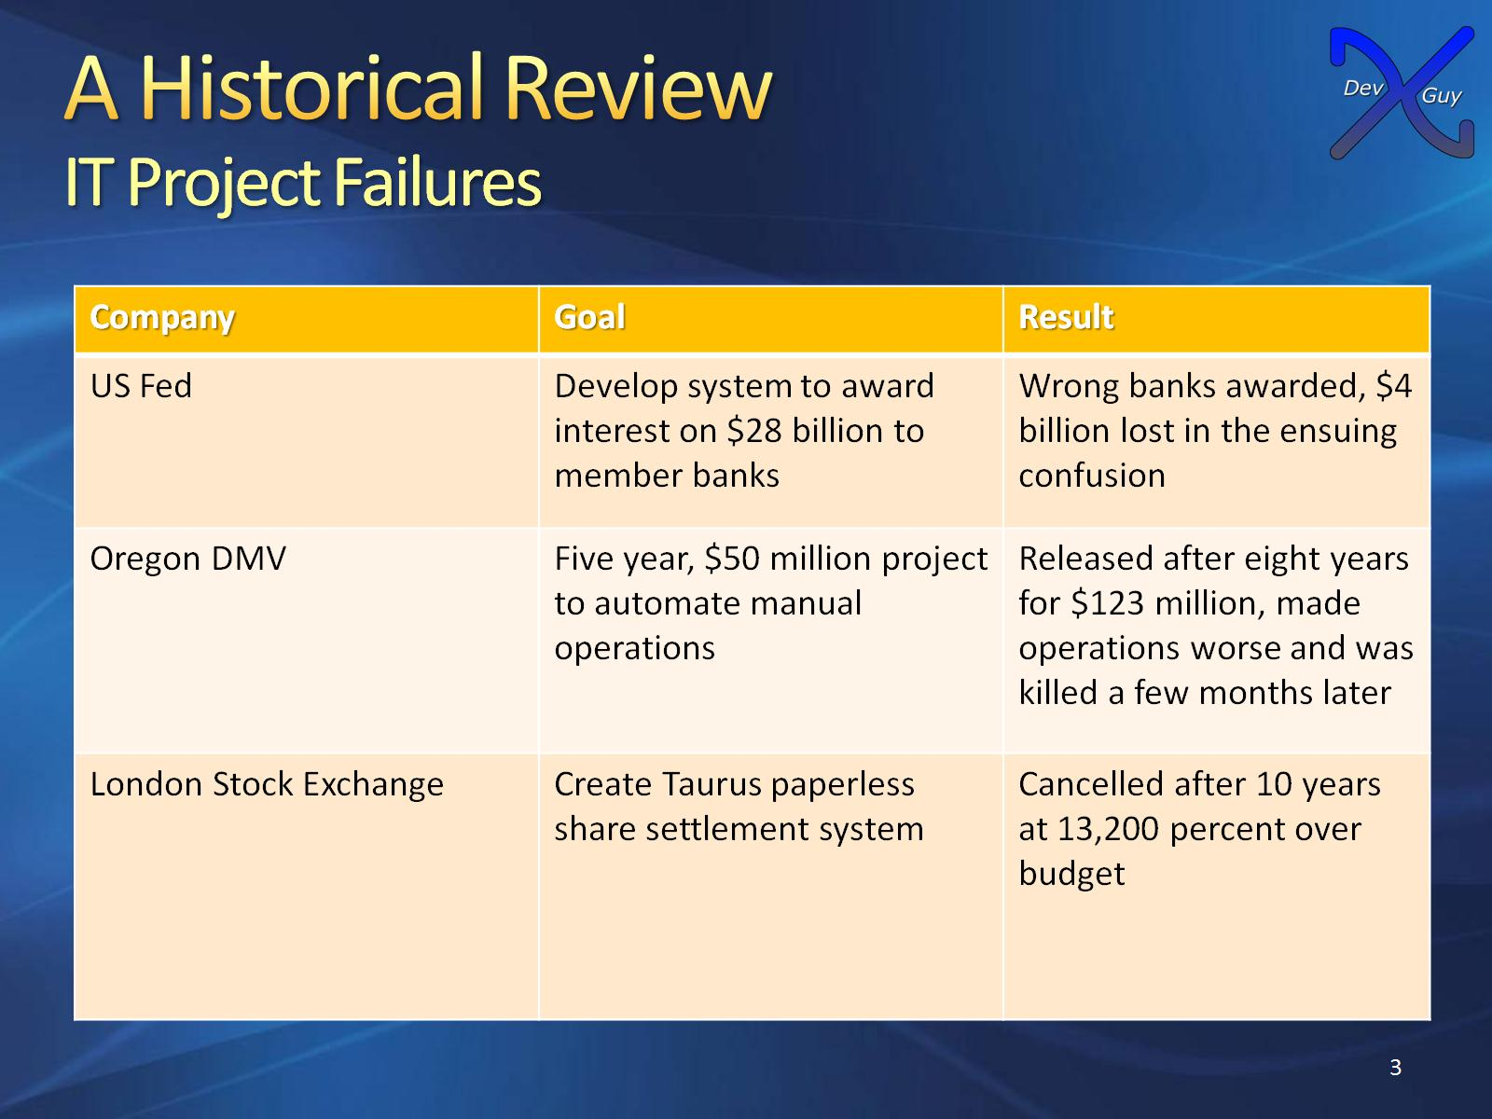
A Historical Review
IT Project Failures

Slide 4
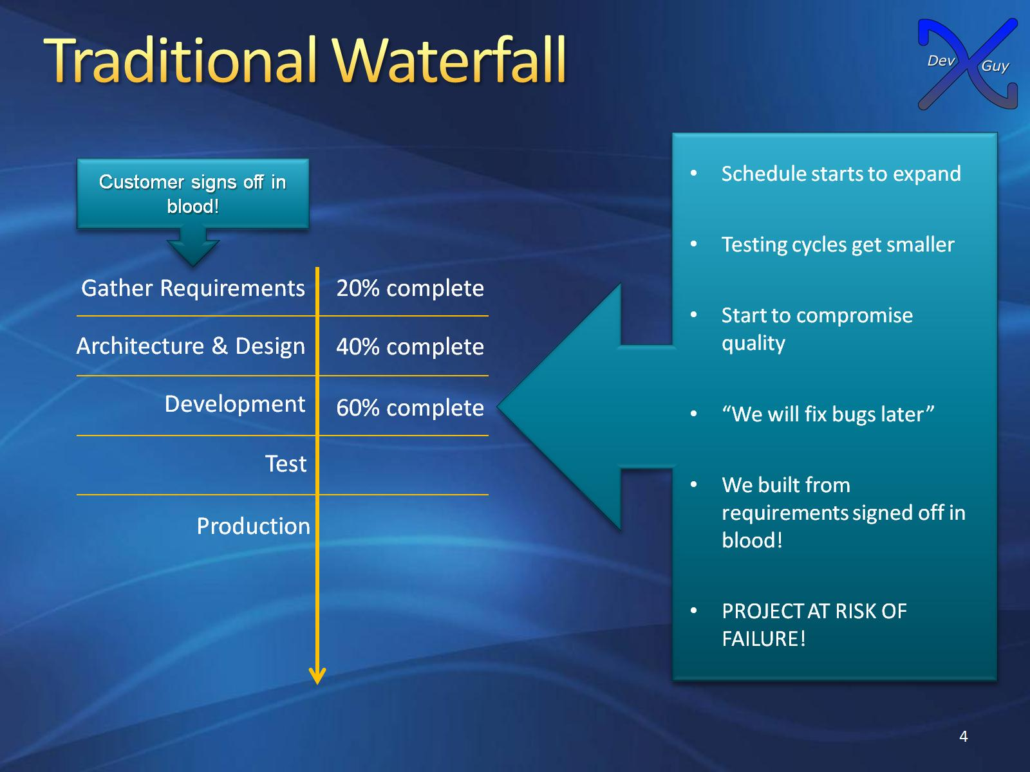
Traditional Waterfall

Slide 5
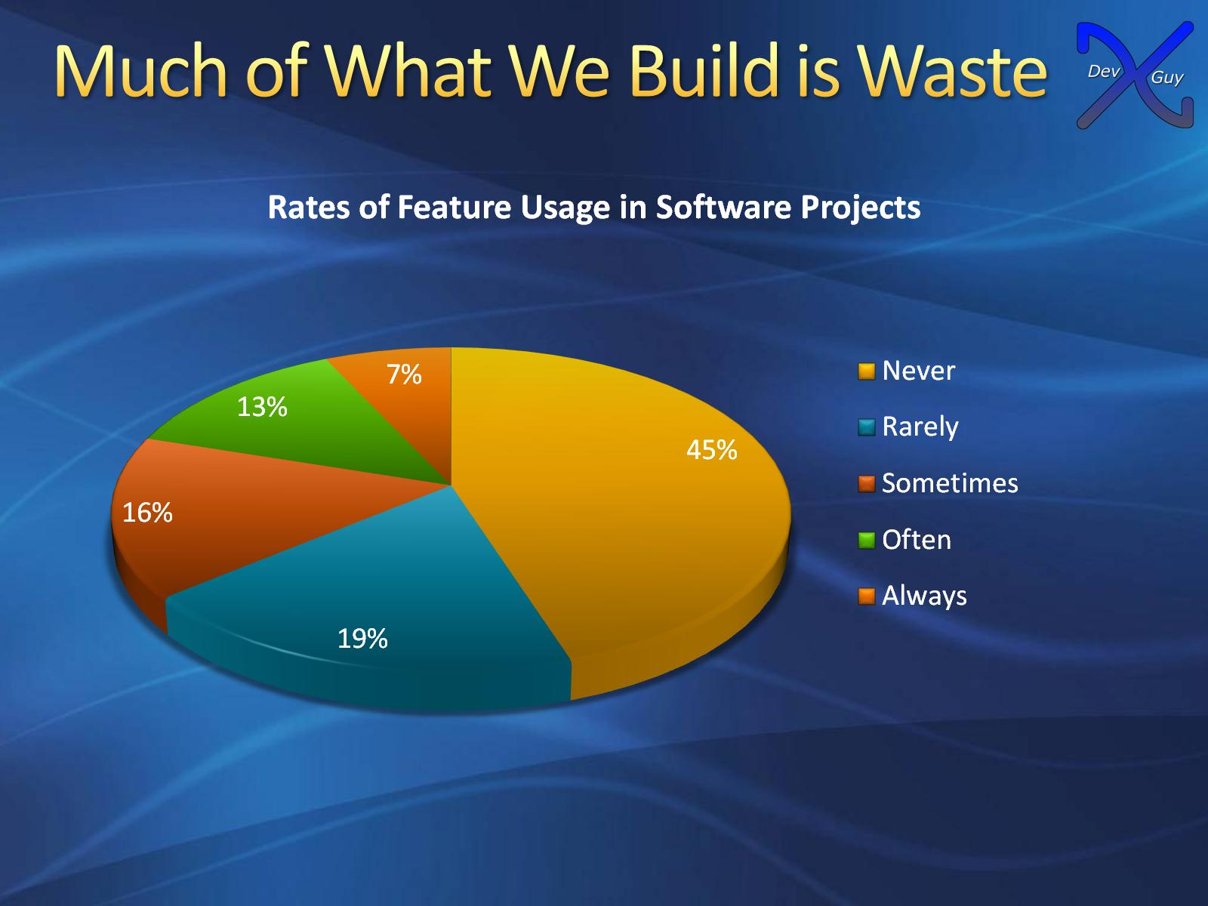
Much of What We Build is Waste

Slide 6
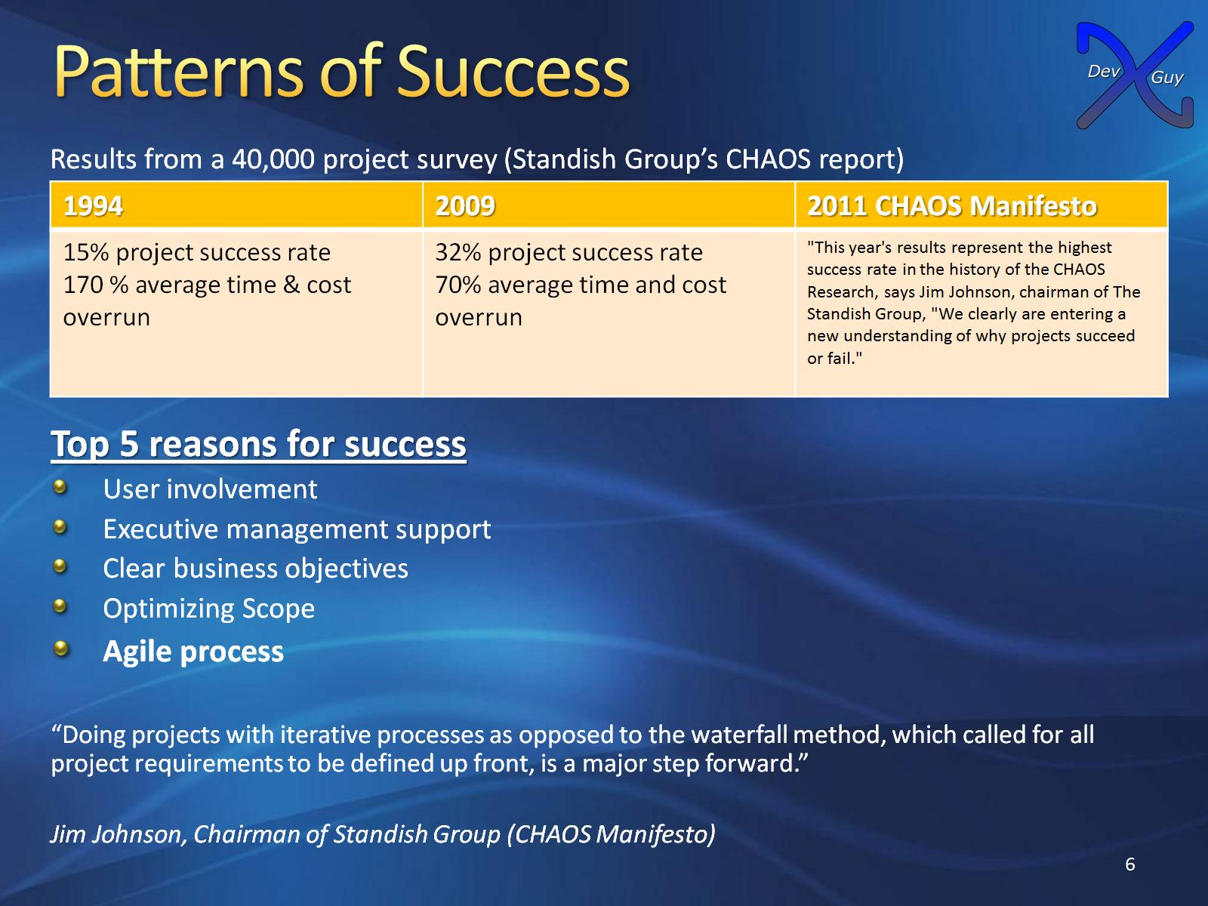
Patterns of Success

Slide 7
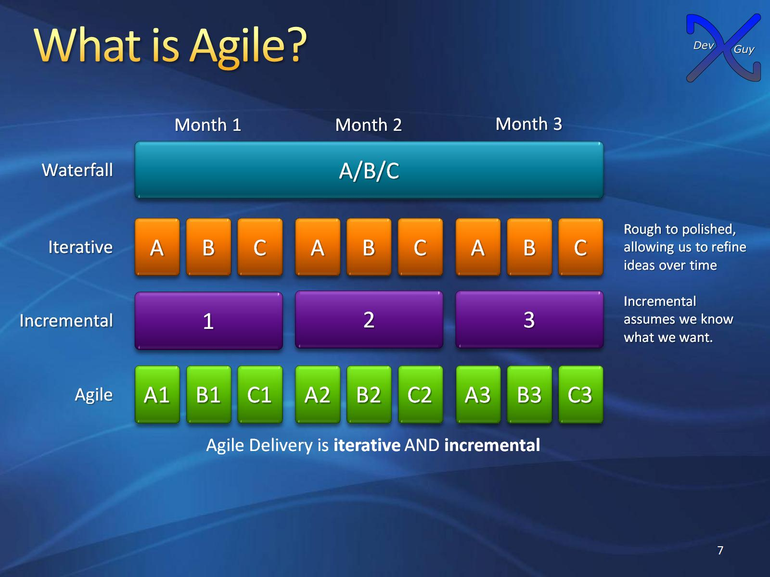
What is Agile?

Slide 8
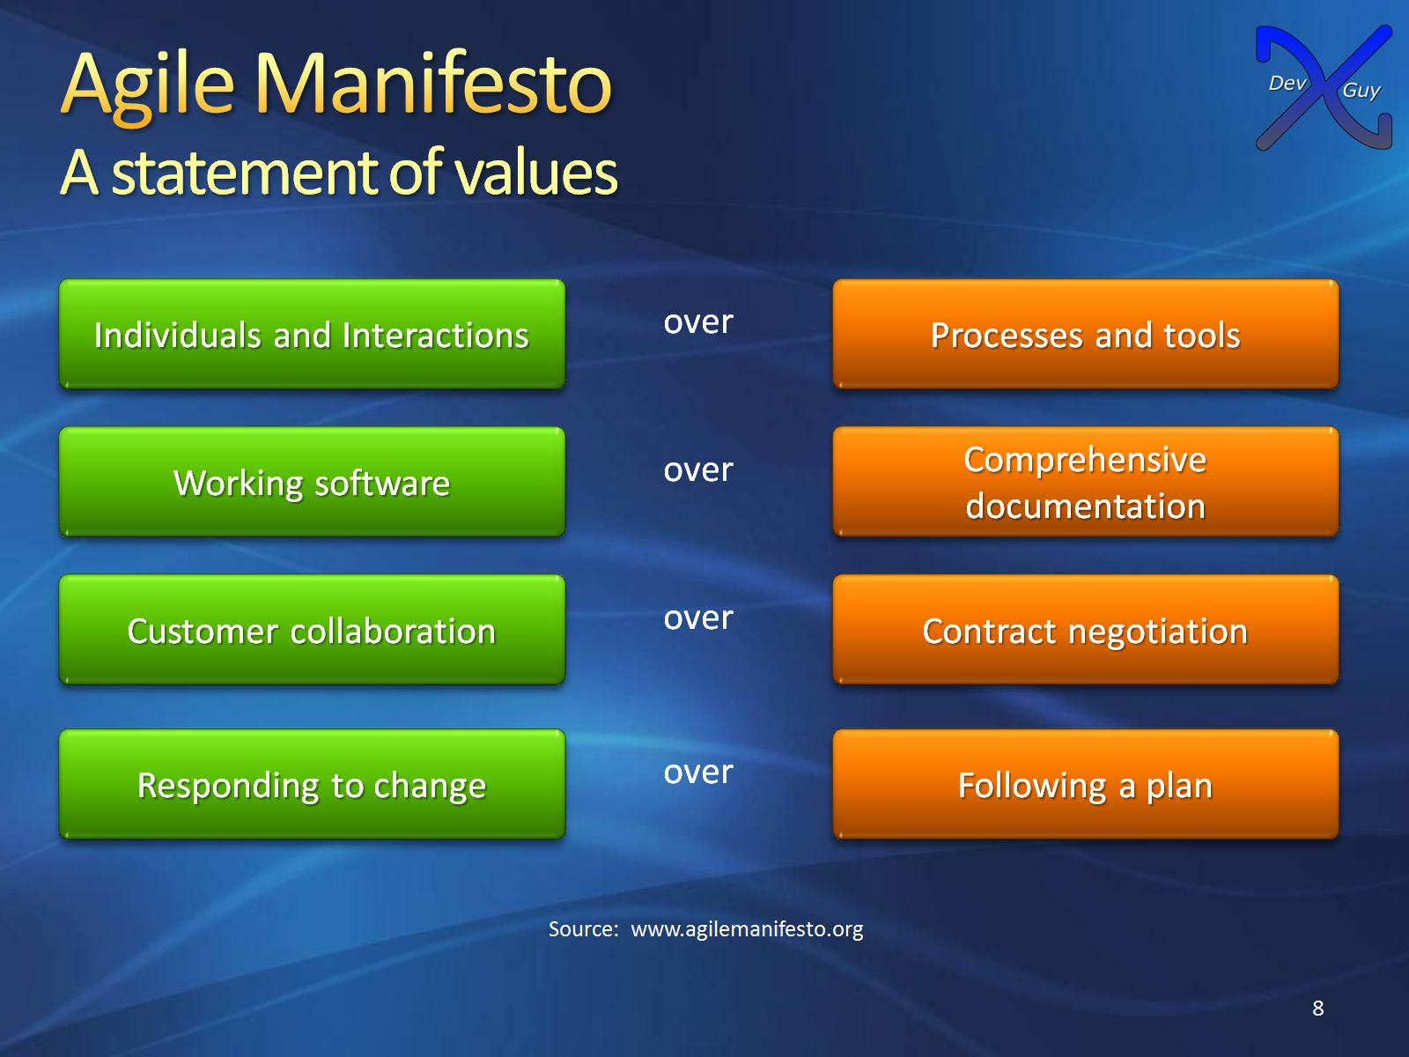
Agile Manifesto
A statement of values

Slide 9
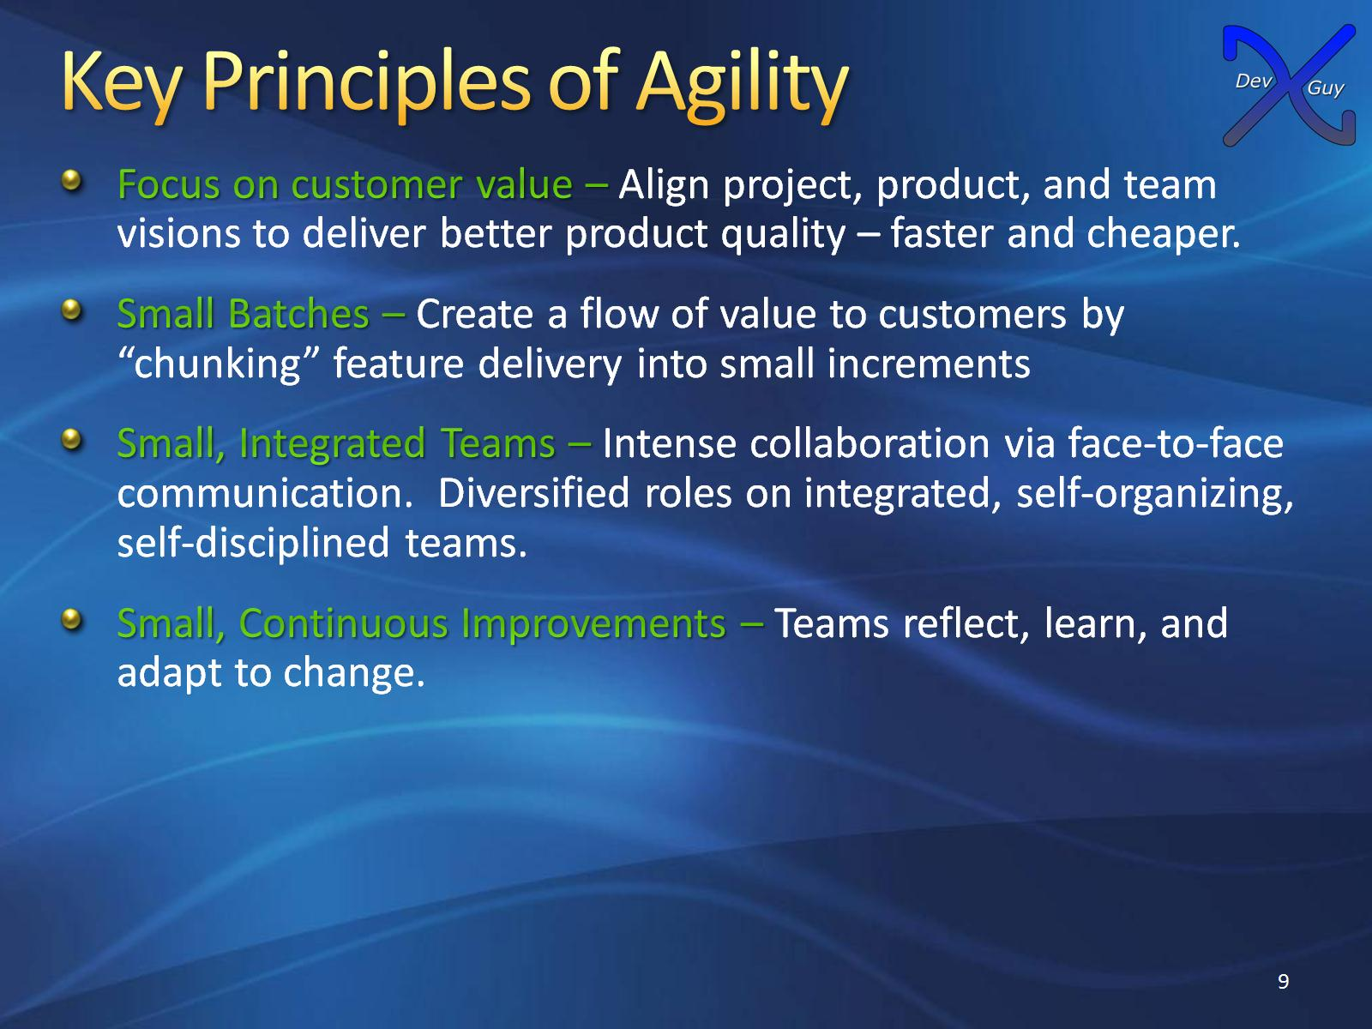
Key Principles of Agility

Slide 10
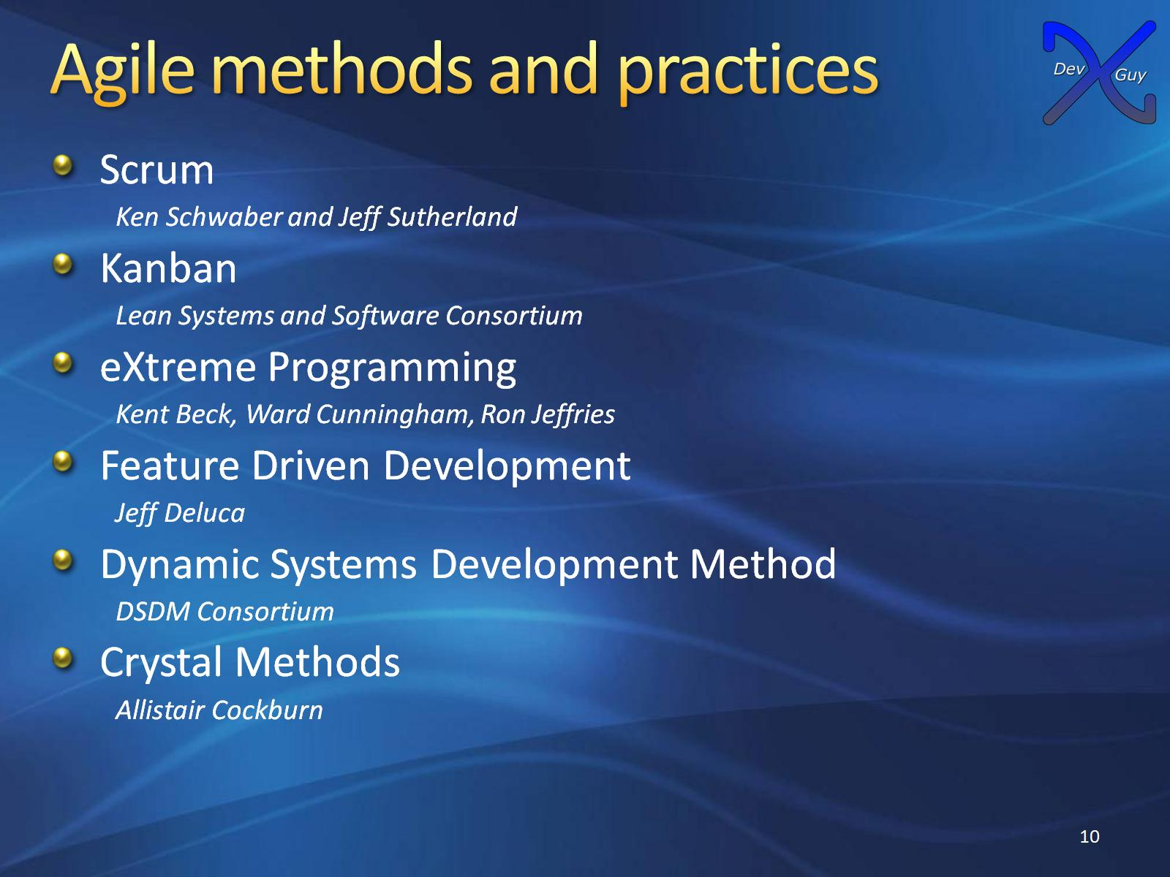
Agile methods and practices

Slide 11
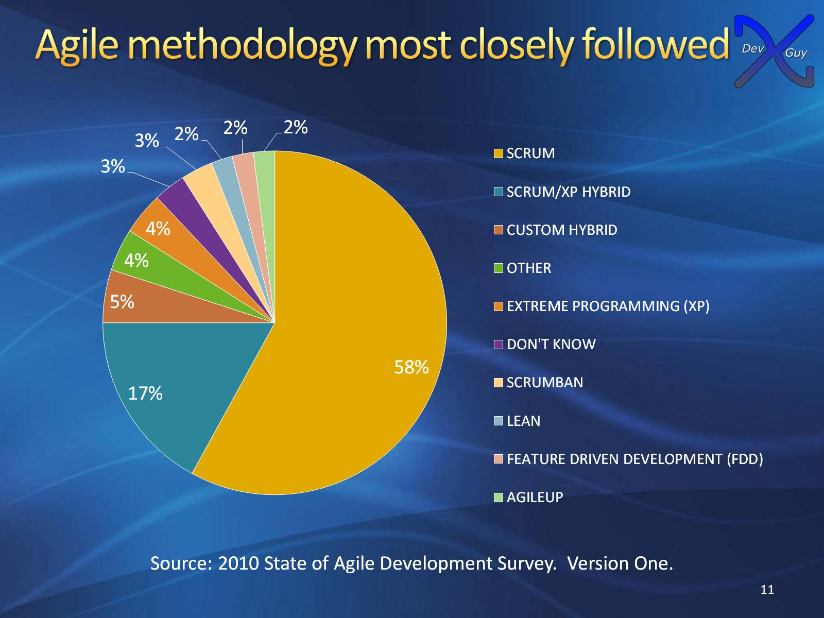
Agile methodology most closely followed

Slide 12
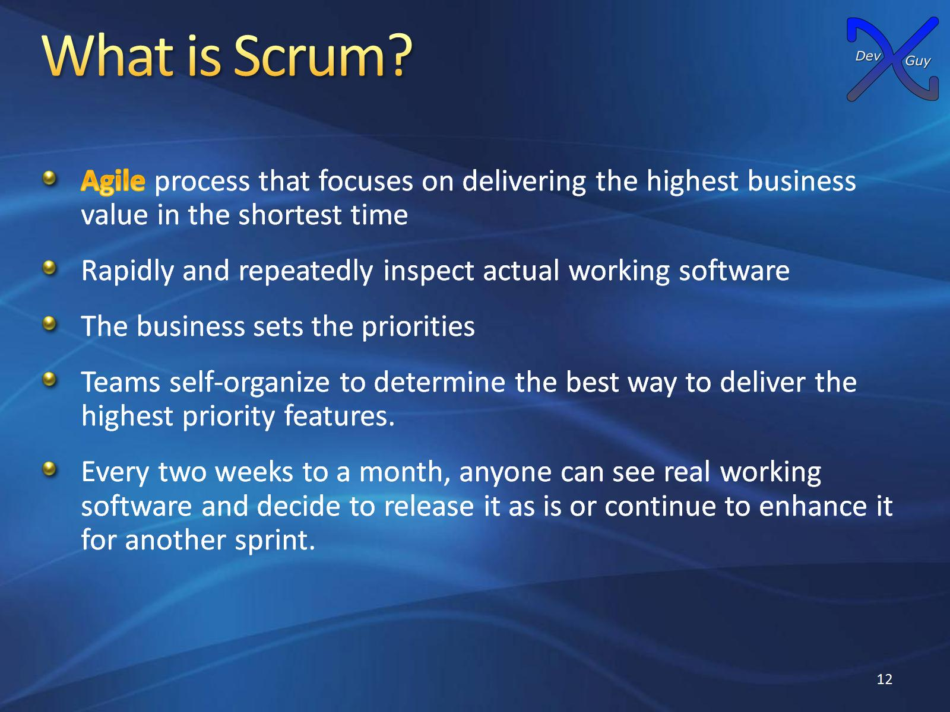
What is Scrum?

Slide 13

Scrum

Slide 14
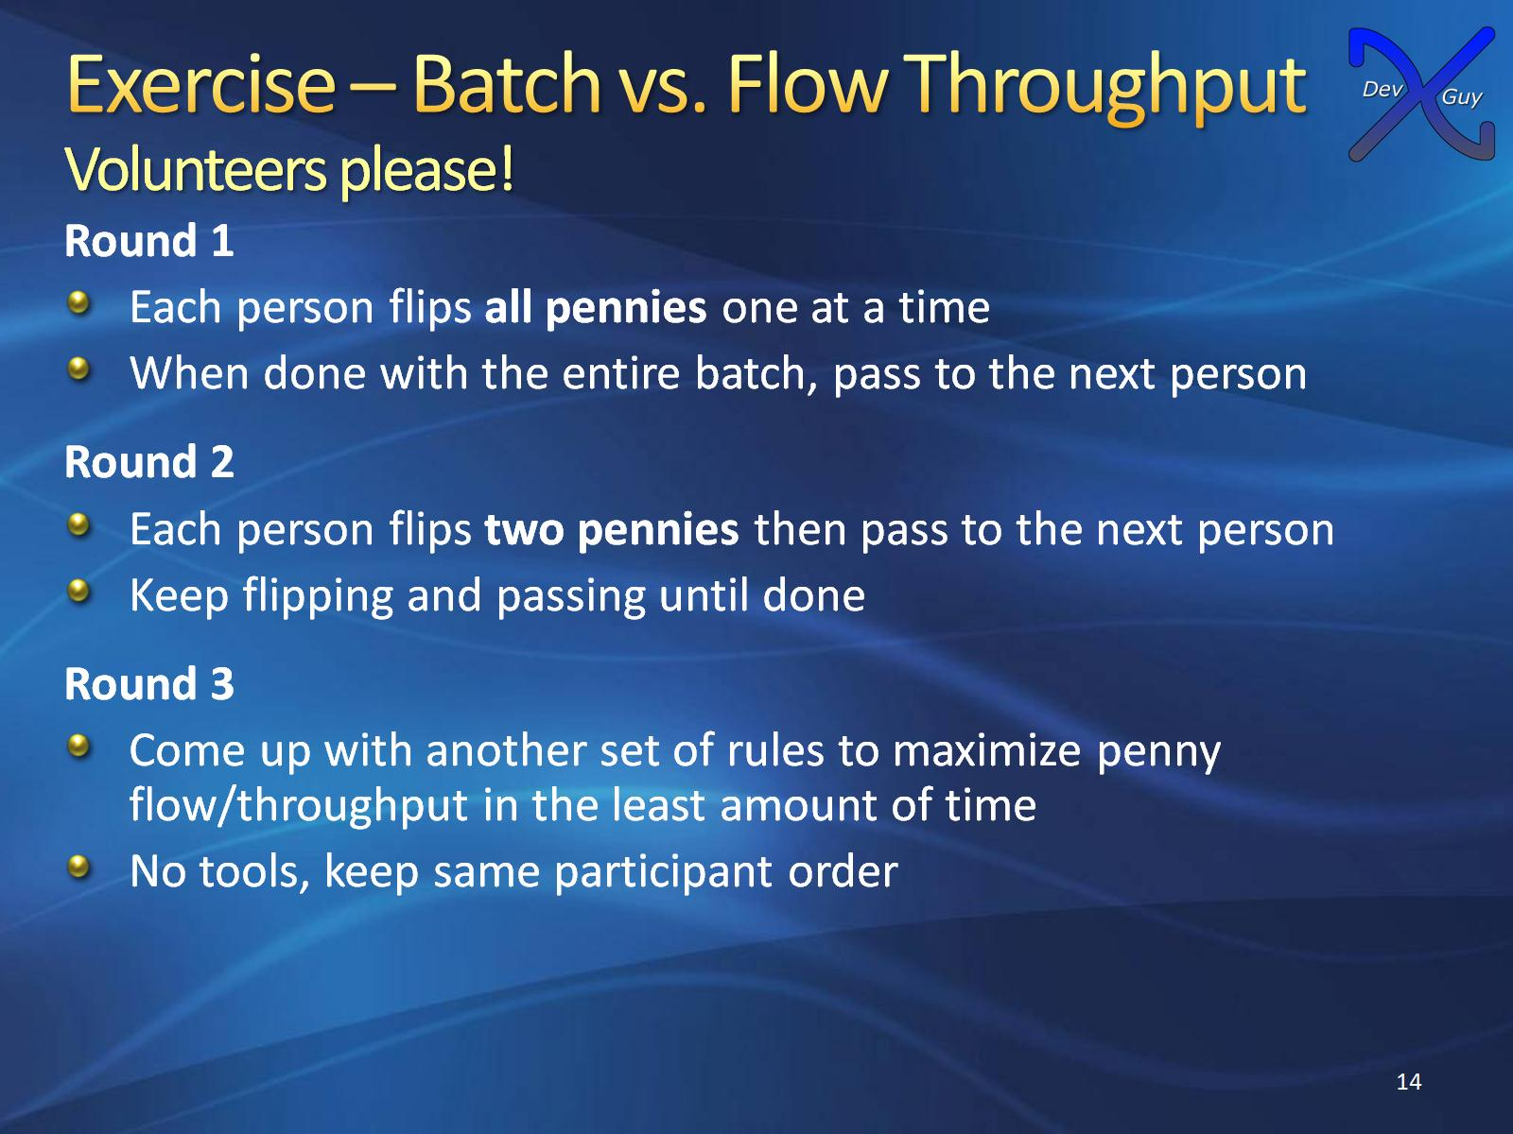
Exercise – Batch vs. Flow Throughput
Volunteers please!

Slide 15
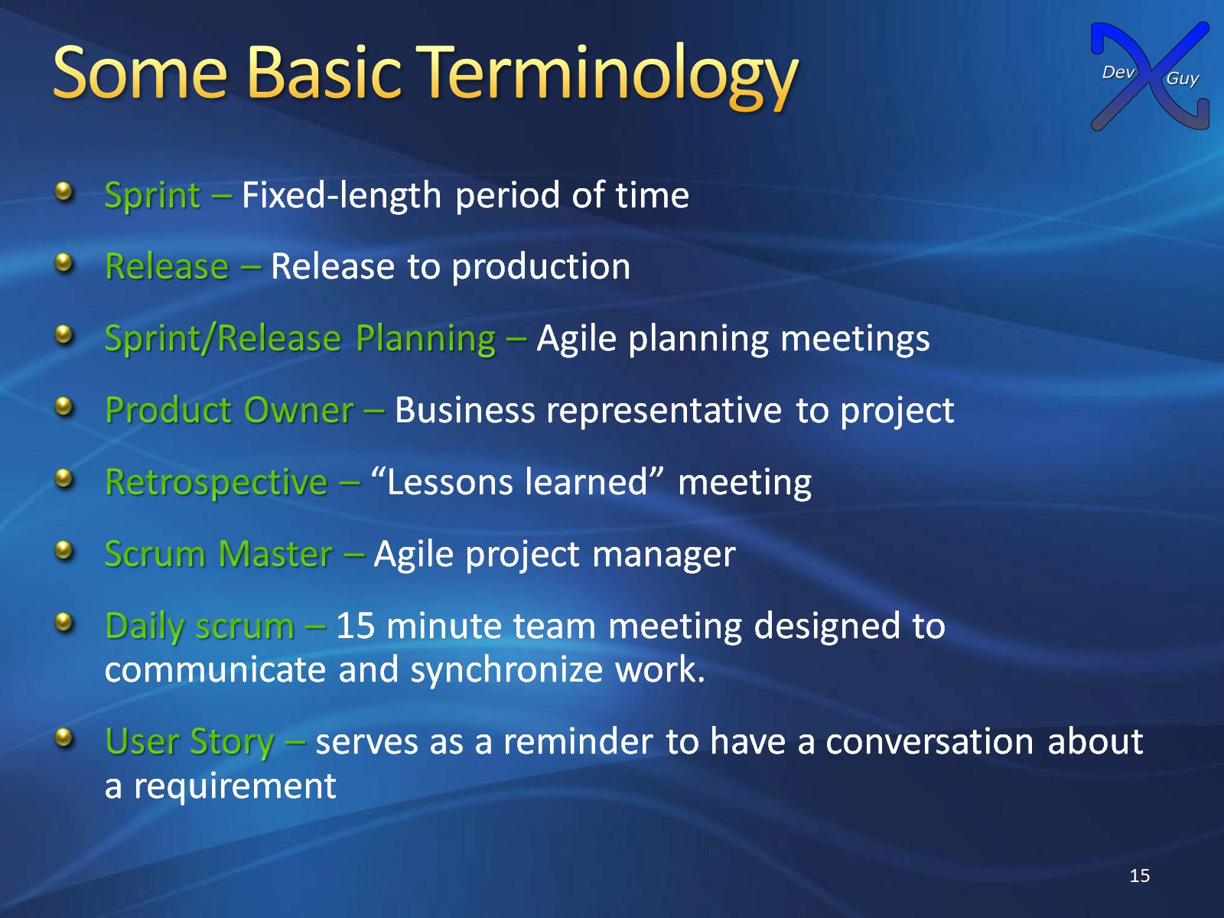
Some Basic Terminology

Slide 16
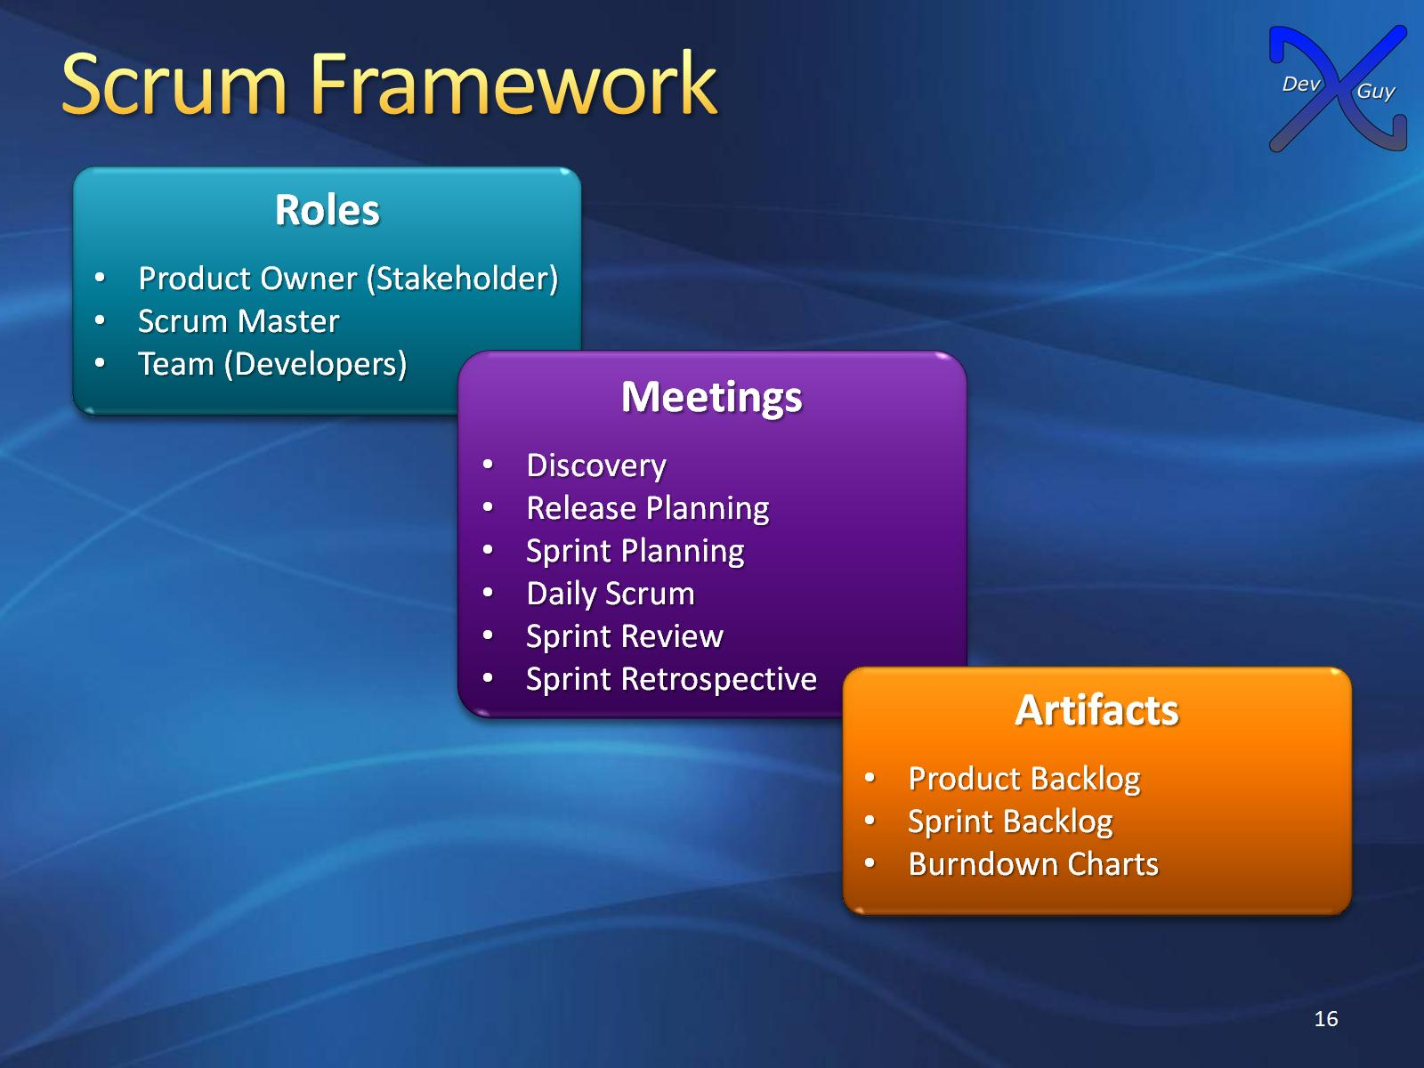
Scrum Framework

Slide 17
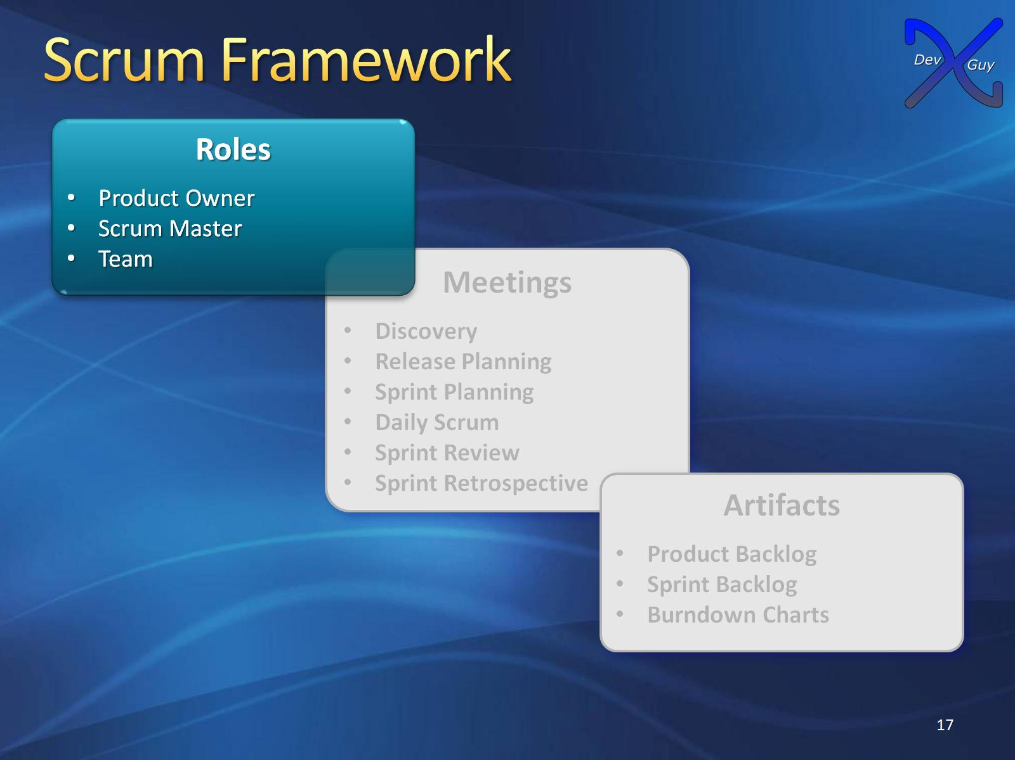
Scrum Framework

Slide 18
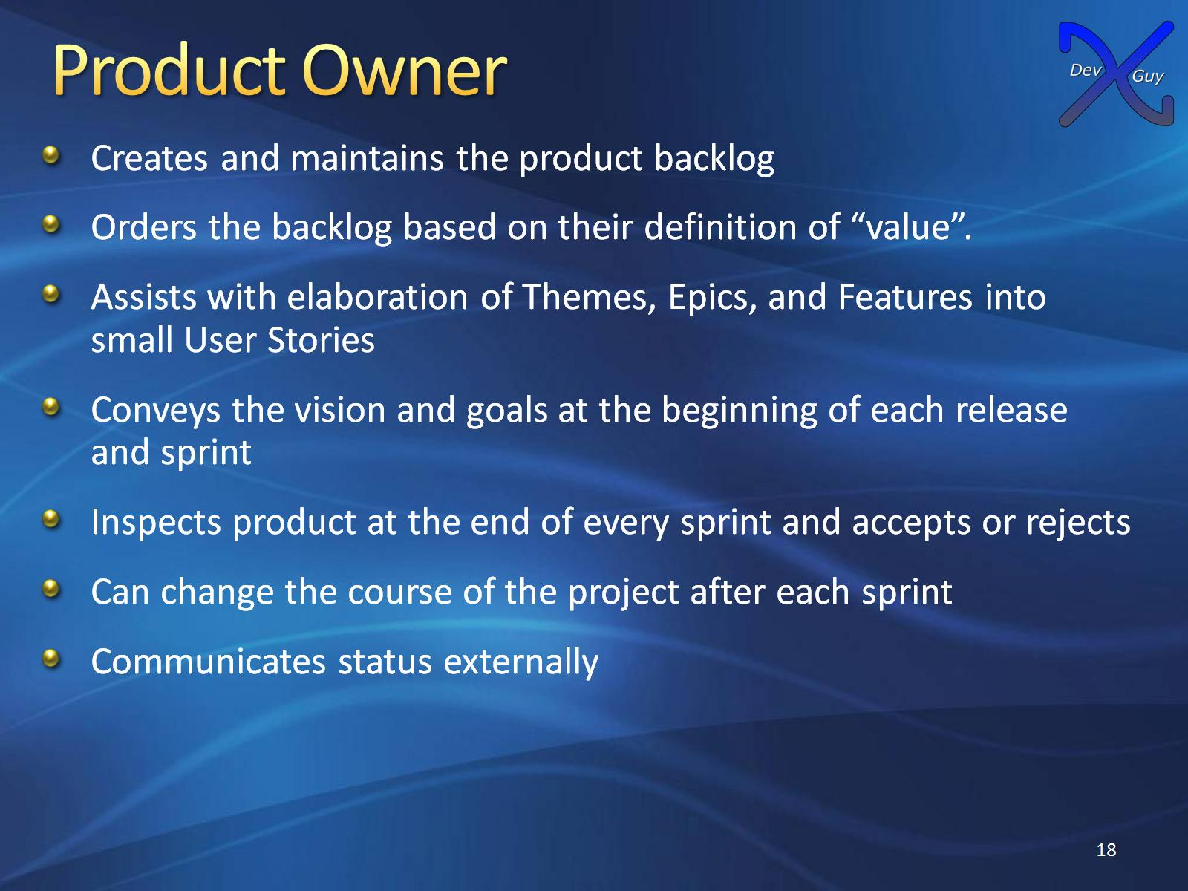
Product Owner

Slide 19
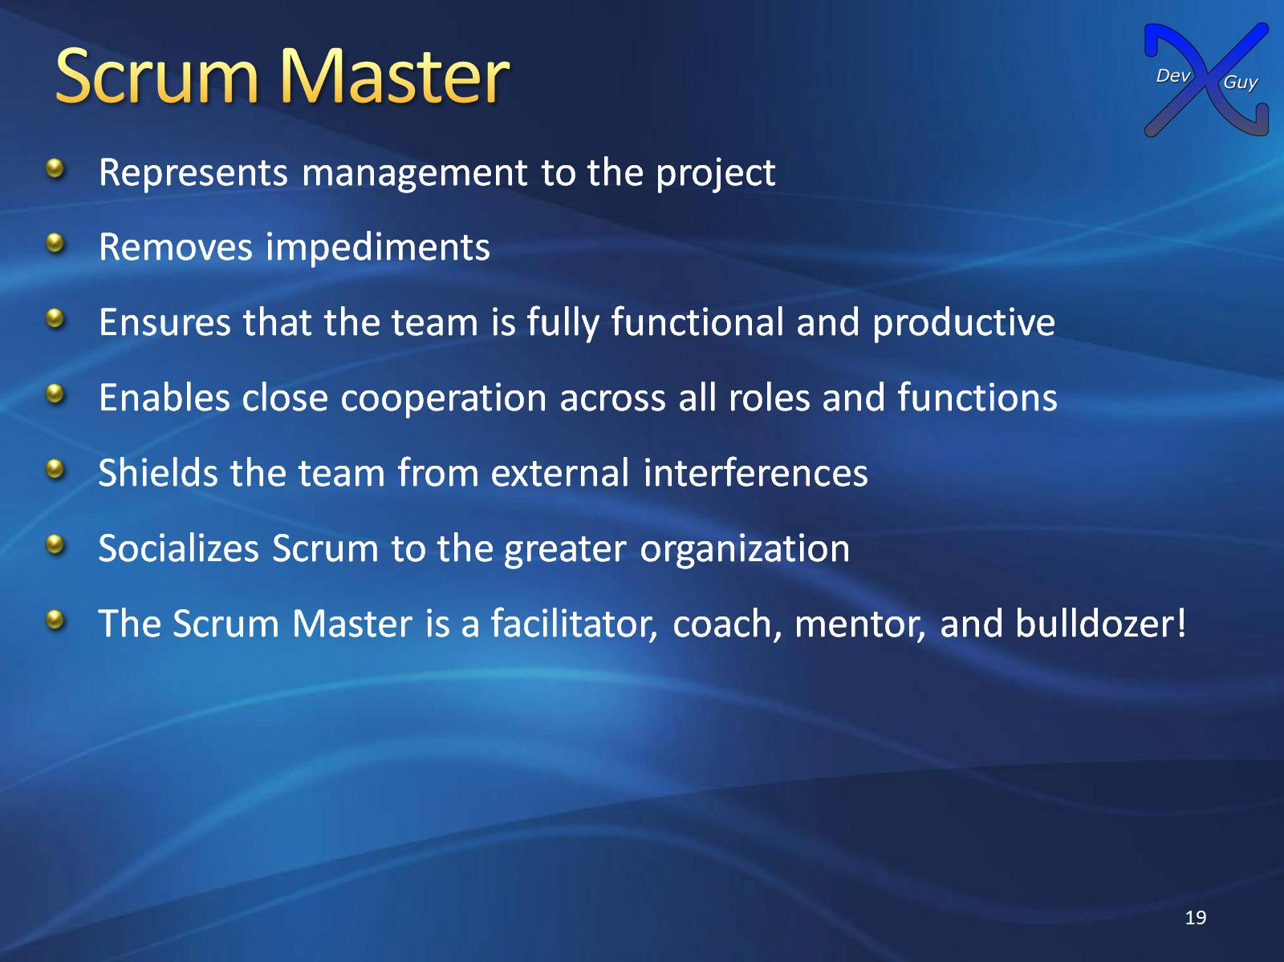
Scrum Master

Slide 20
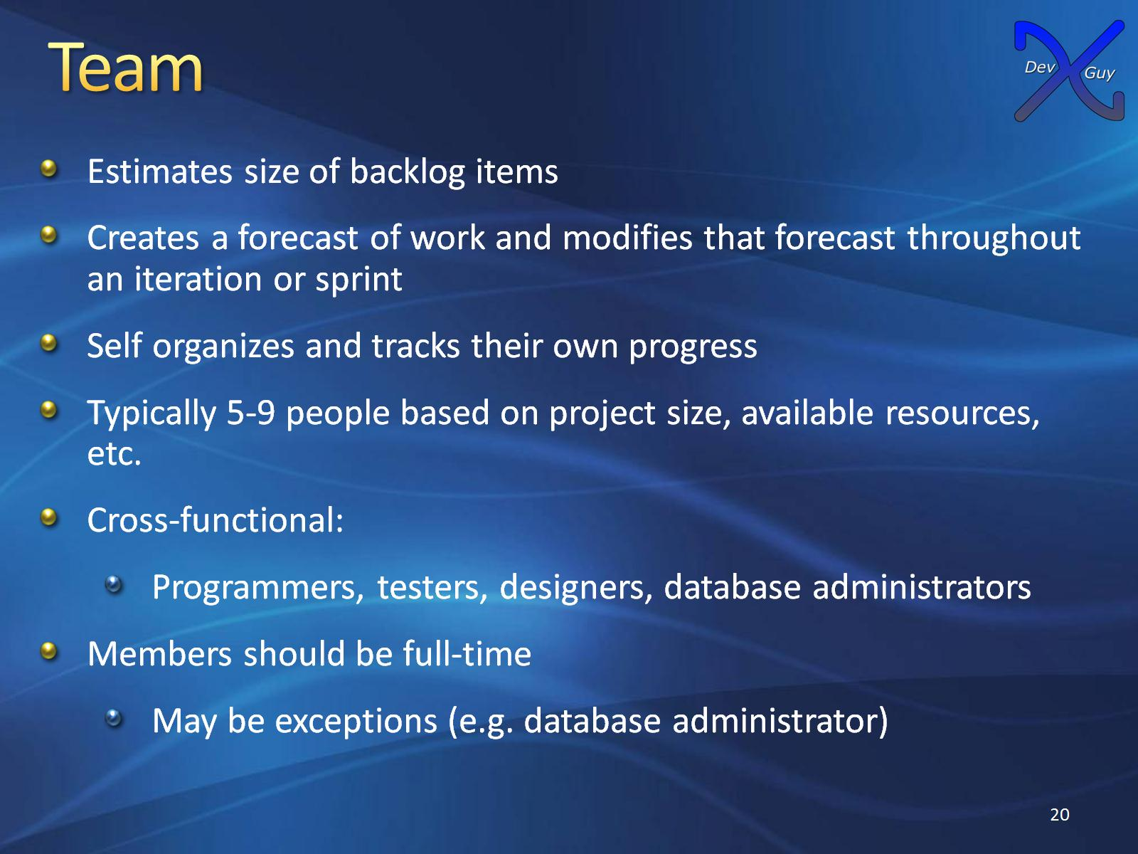
Team

Slide 21
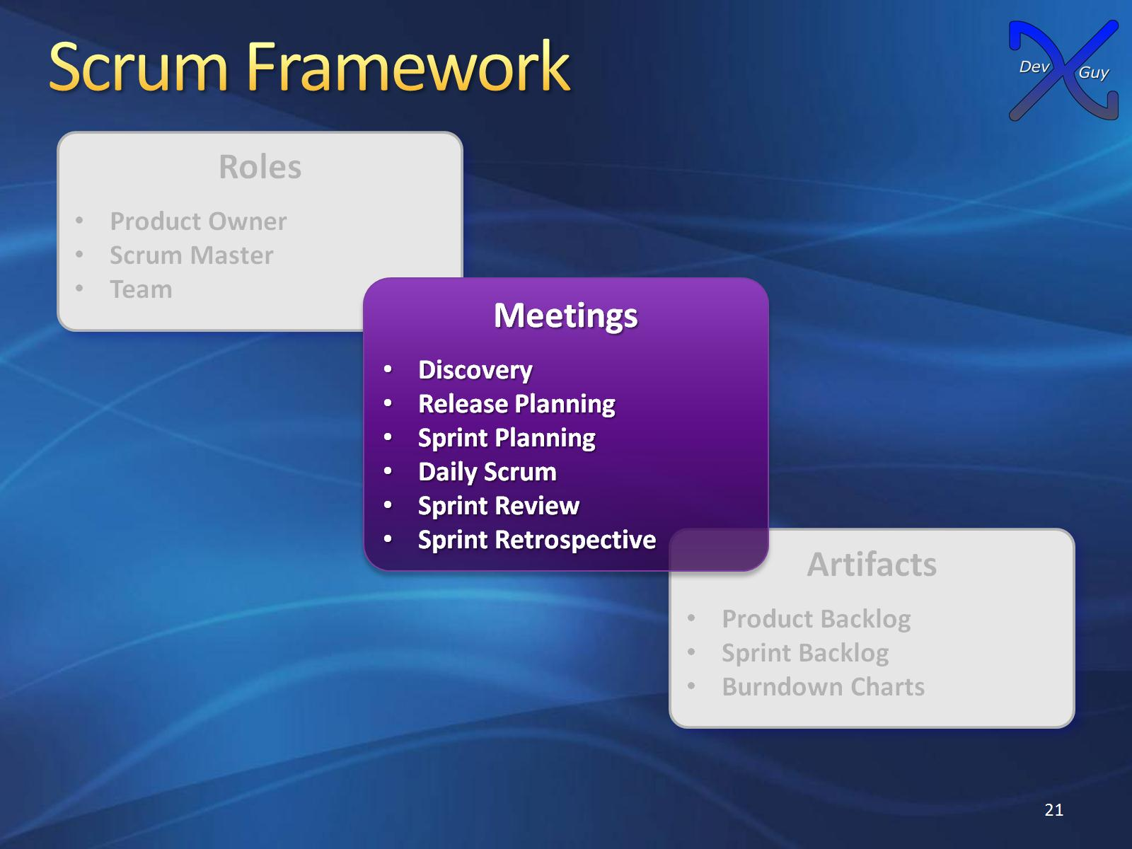
Scrum Framework

Slide 22
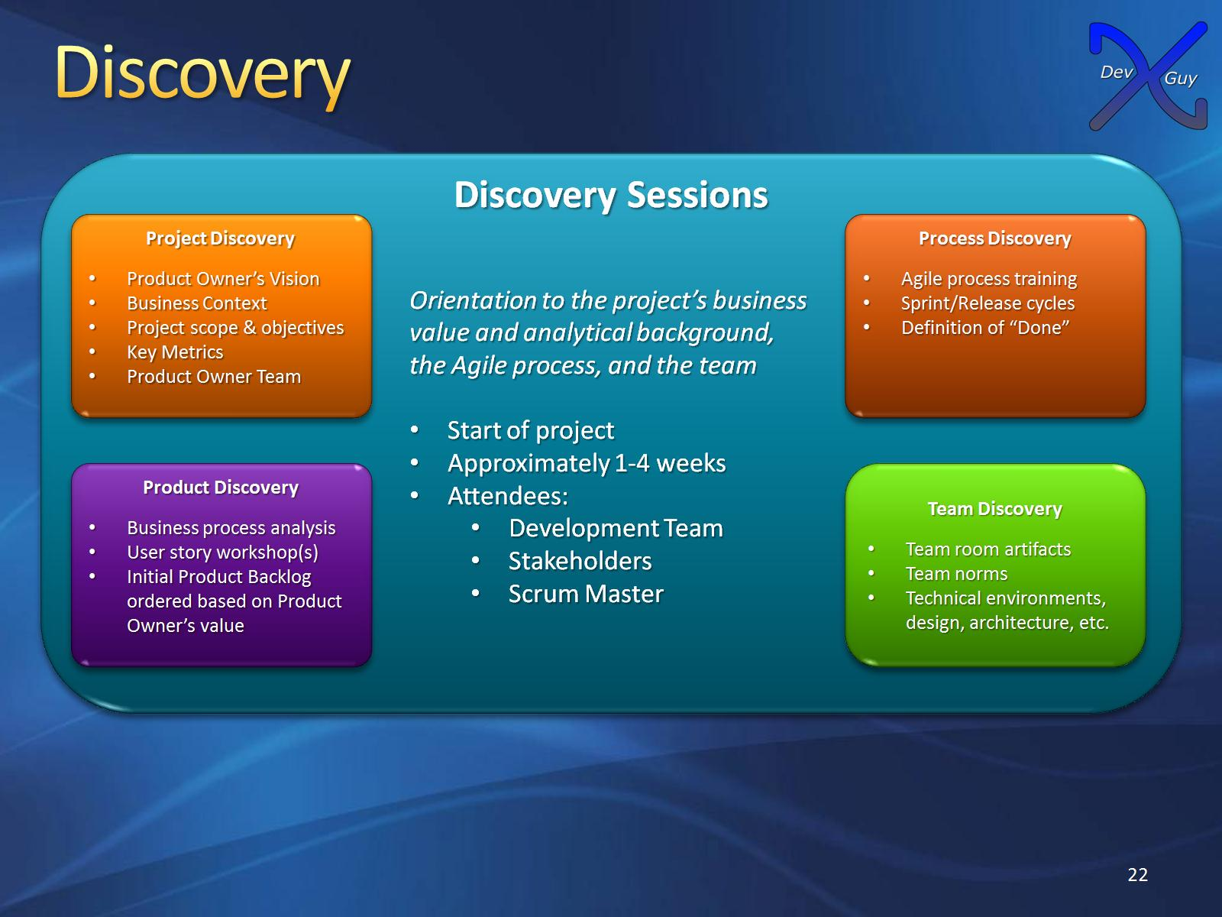
Discovery

Slide 23
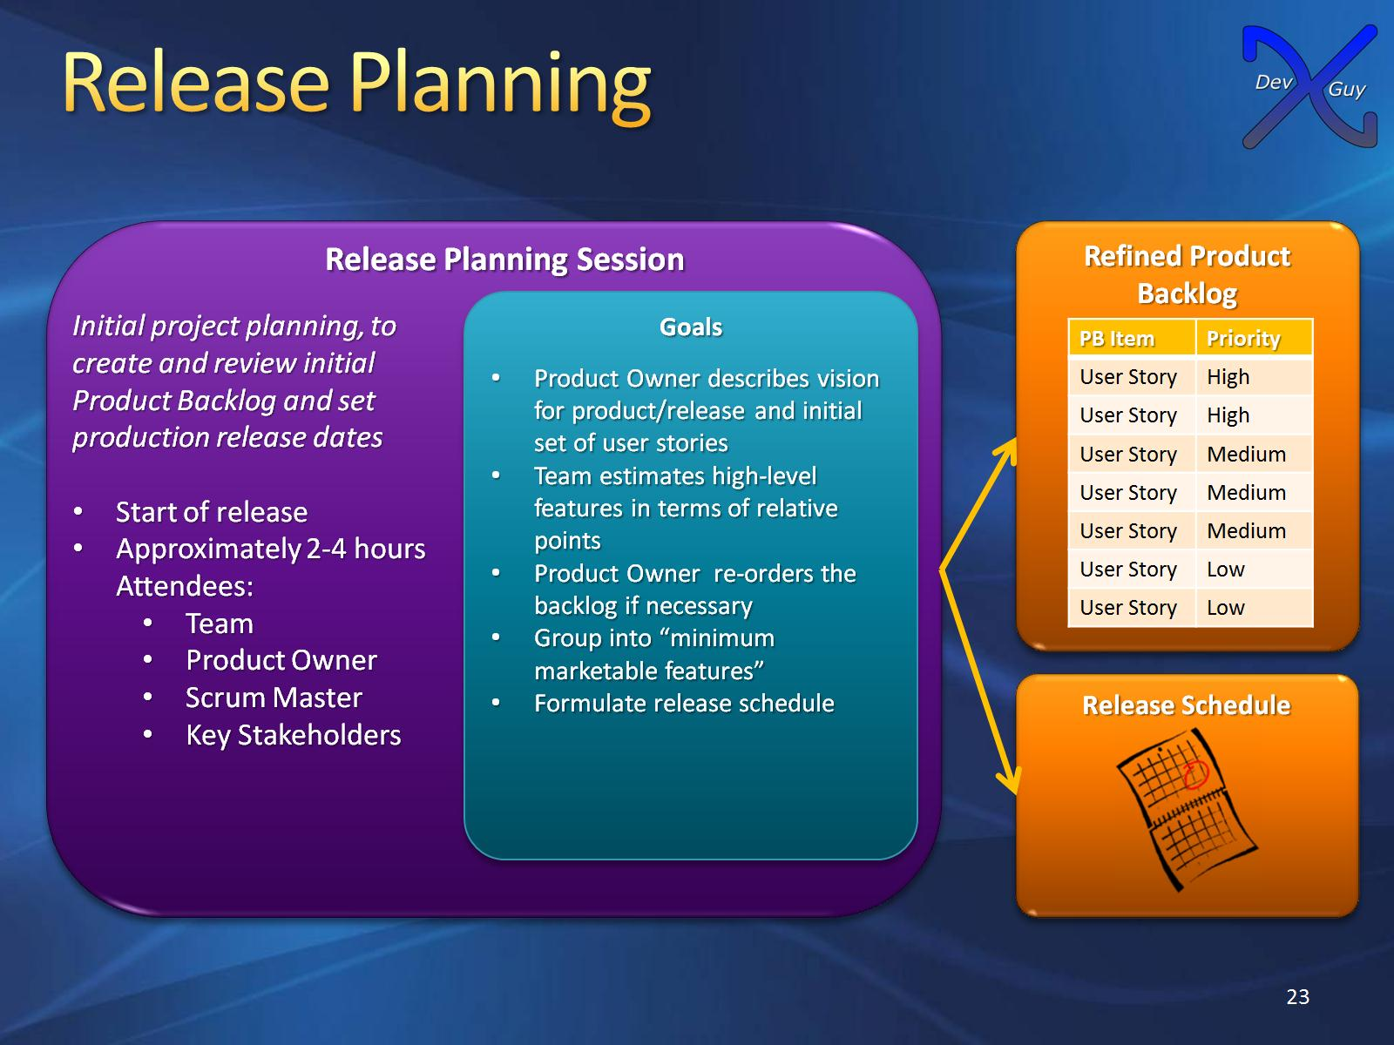
Release Planning

Slide 24
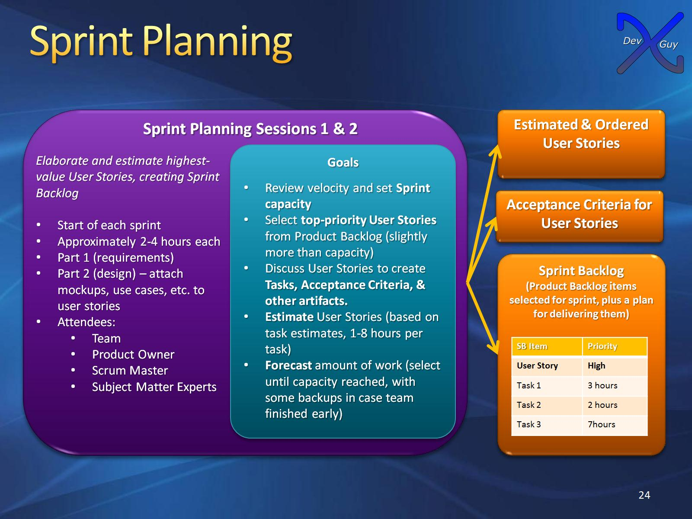
Sprint Planning

Slide 25
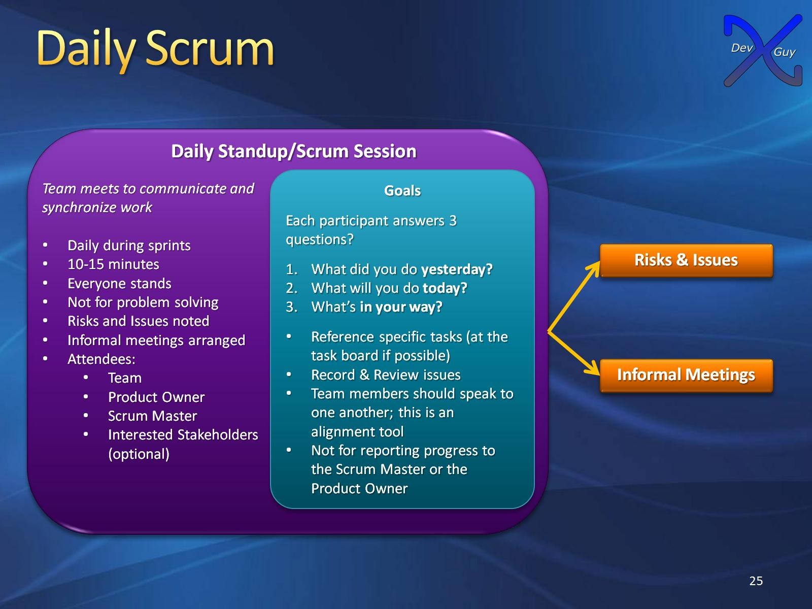
Daily Scrum

Slide 26
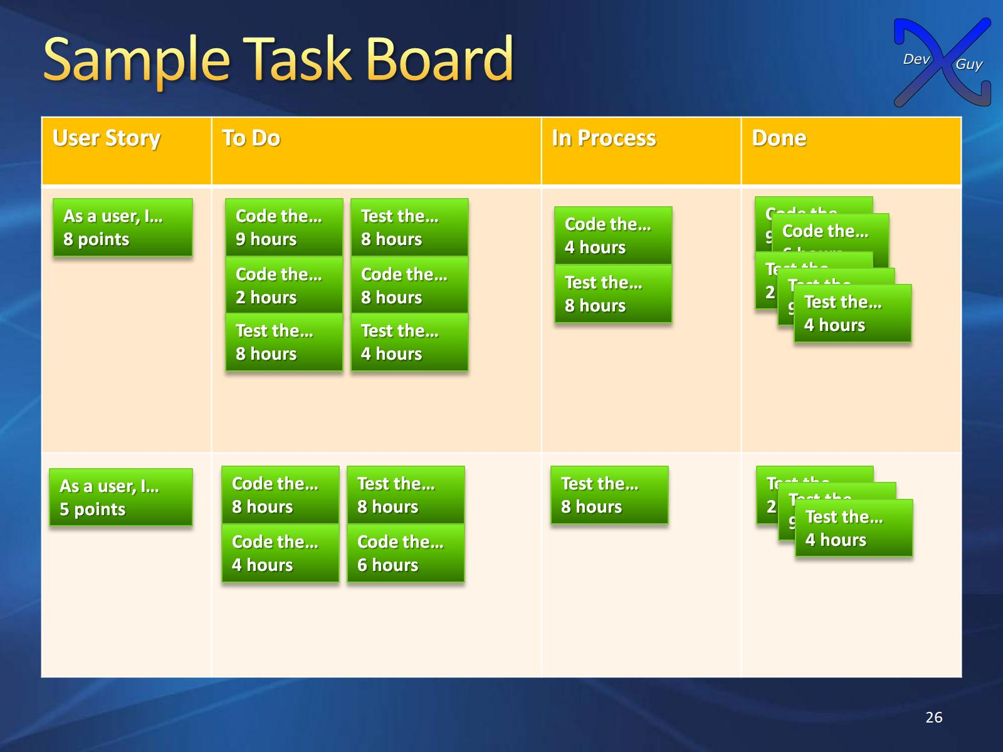
Sample Task Board

Slide 27
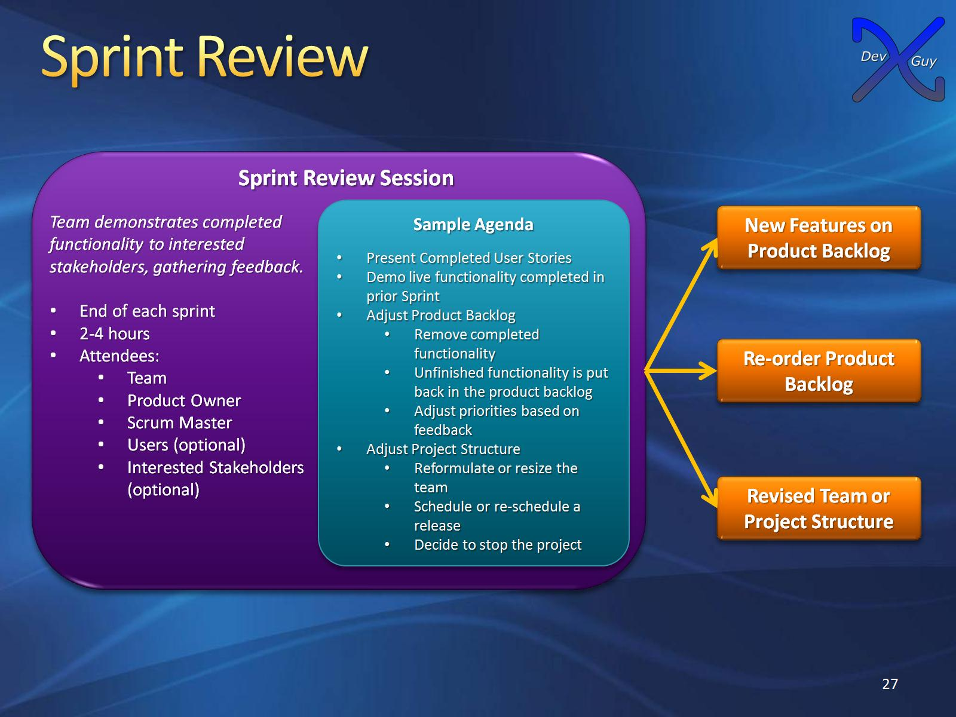
Sprint Review

Slide 28
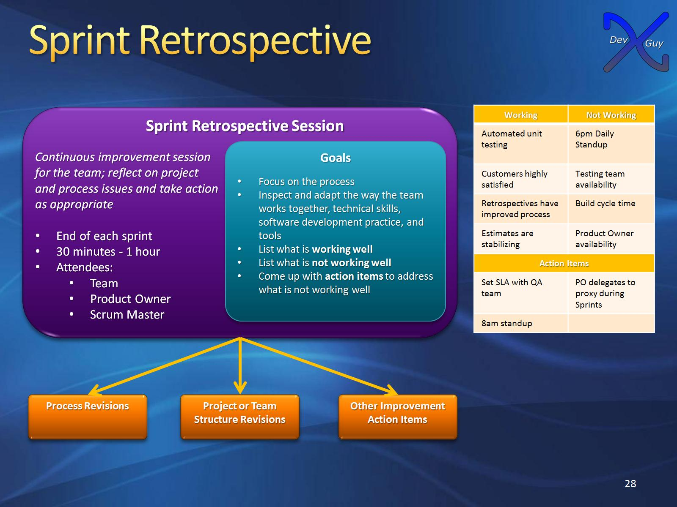
Sprint Retrospective

Slide 29
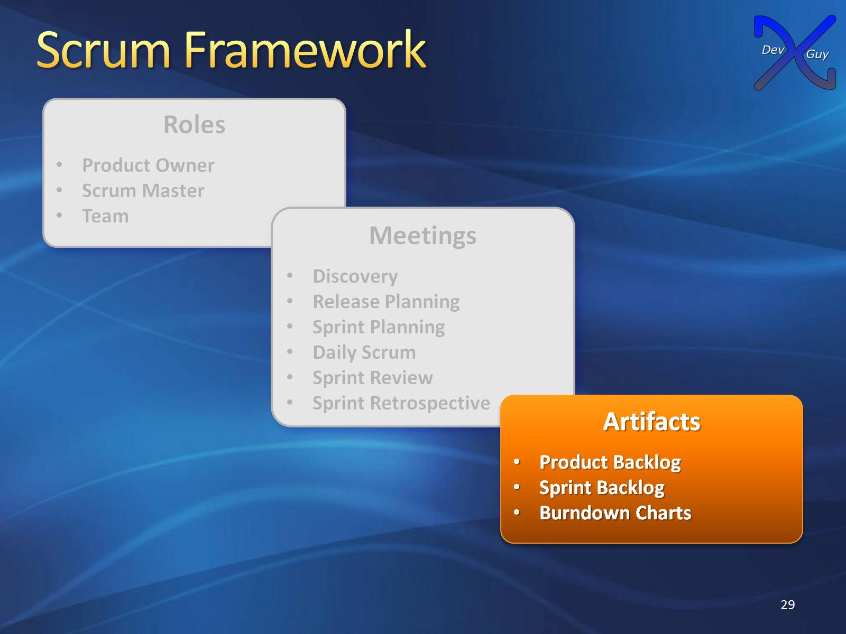
Scrum Framework

Slide 30
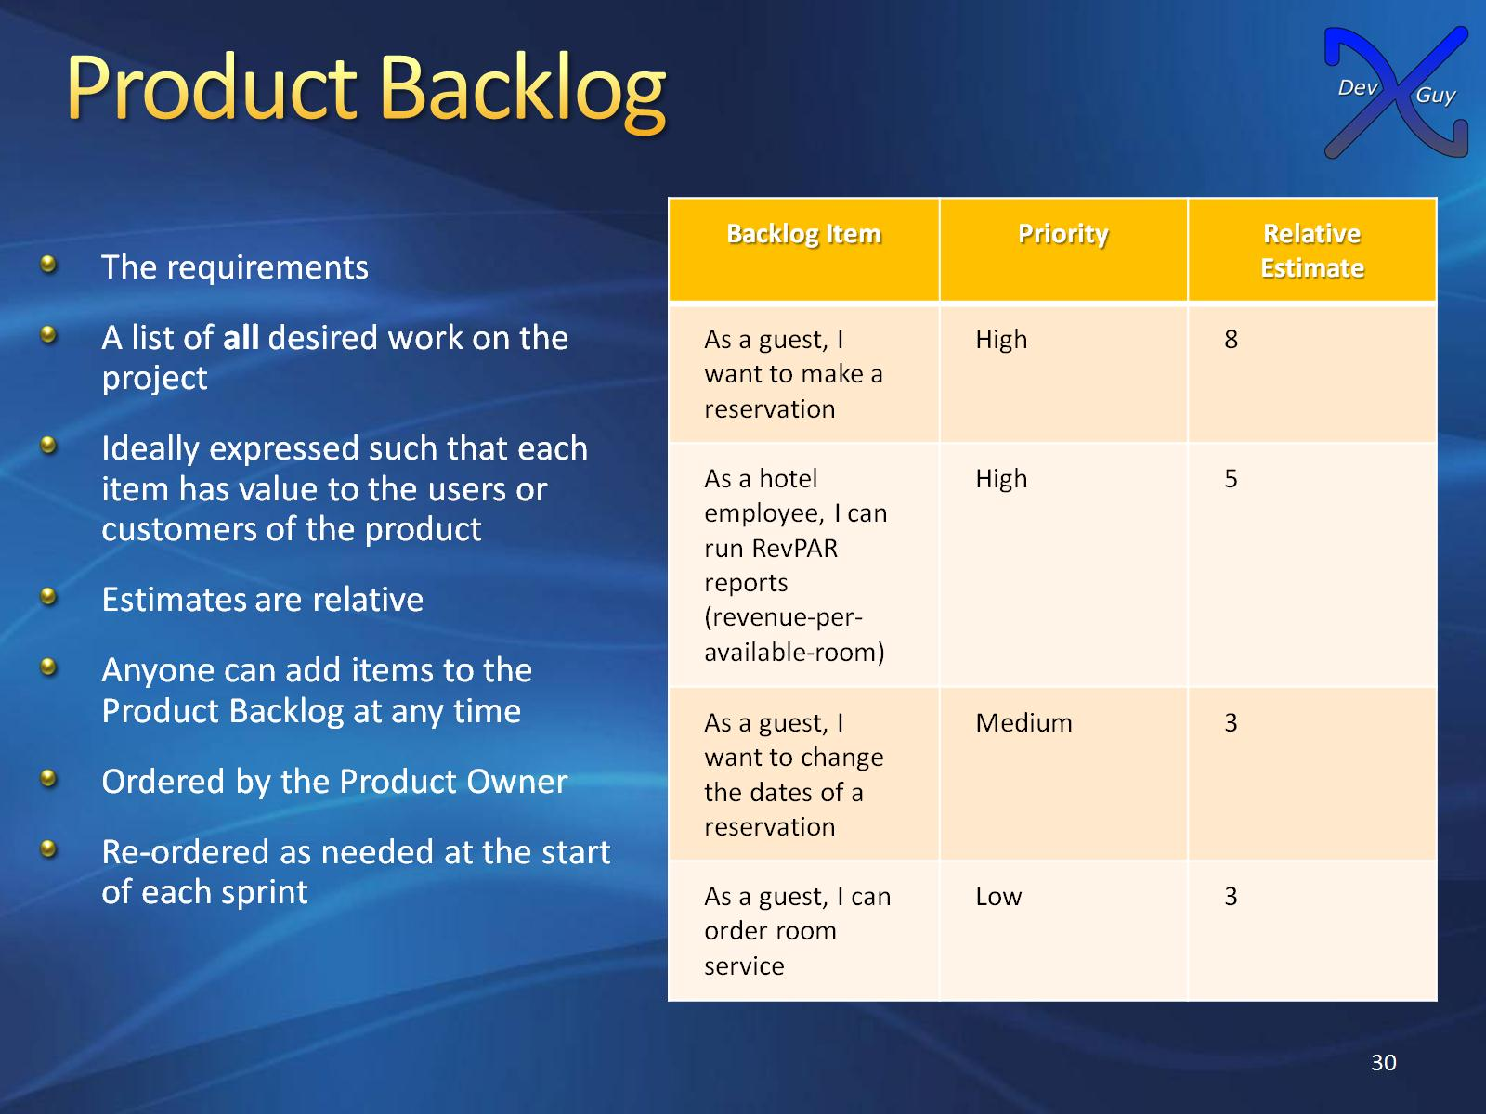
Product Backlog

Slide 31
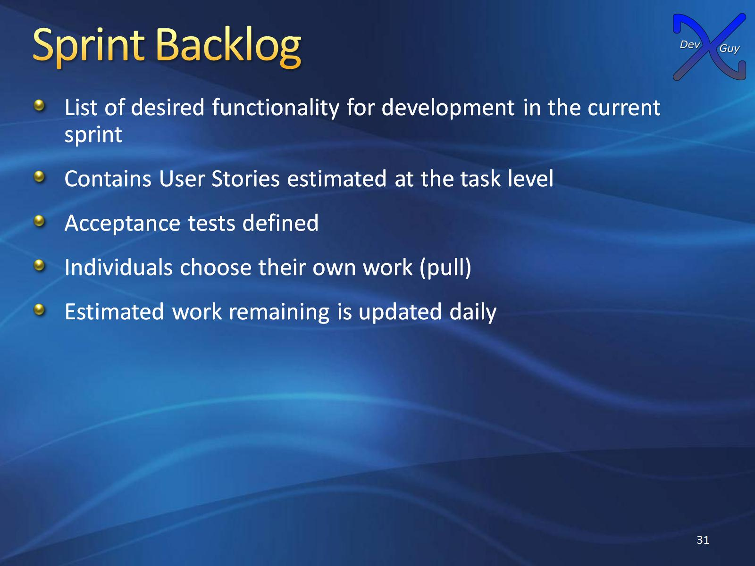
Sprint Backlog

Slide 32
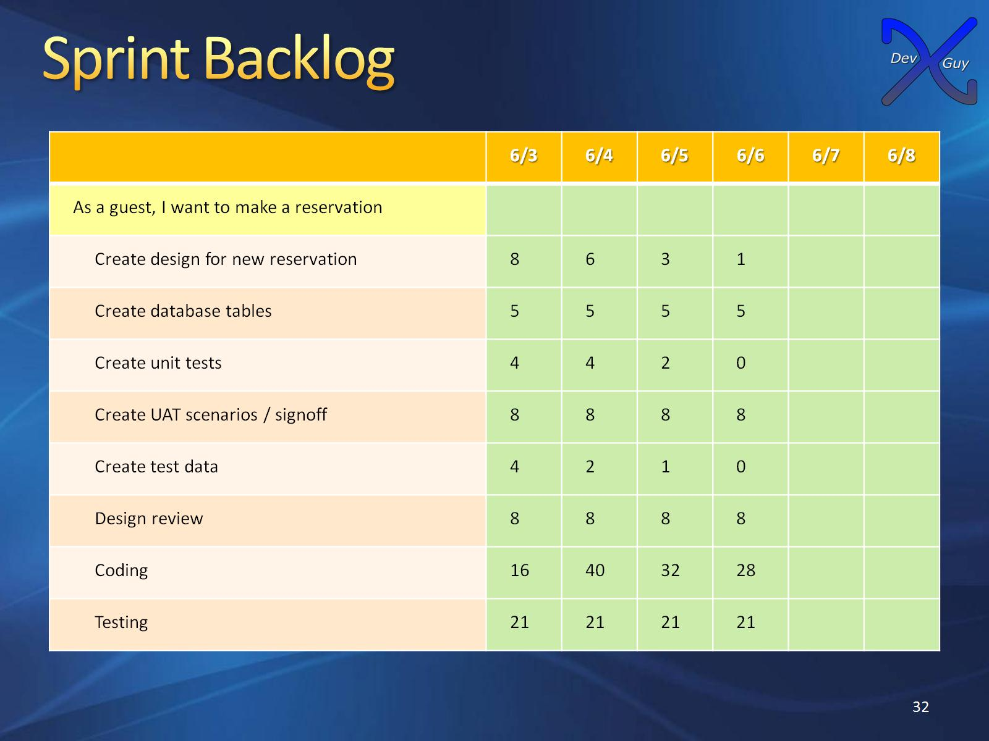
Sprint Backlog

Slide 33
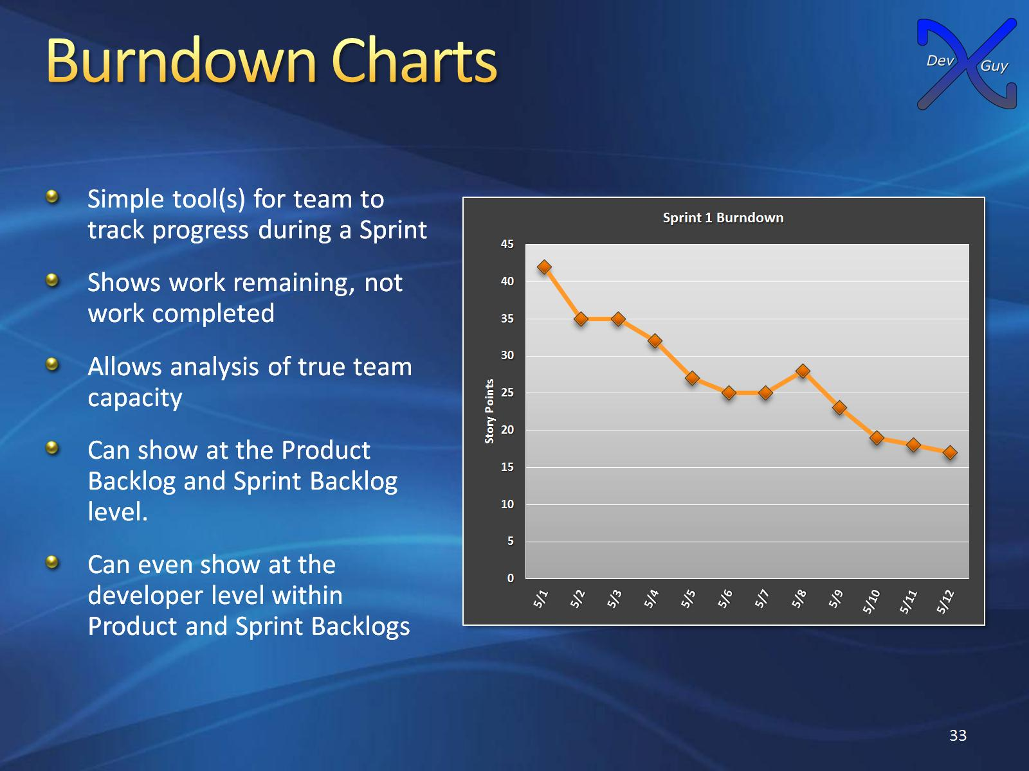
Burndown Charts

Slide 34
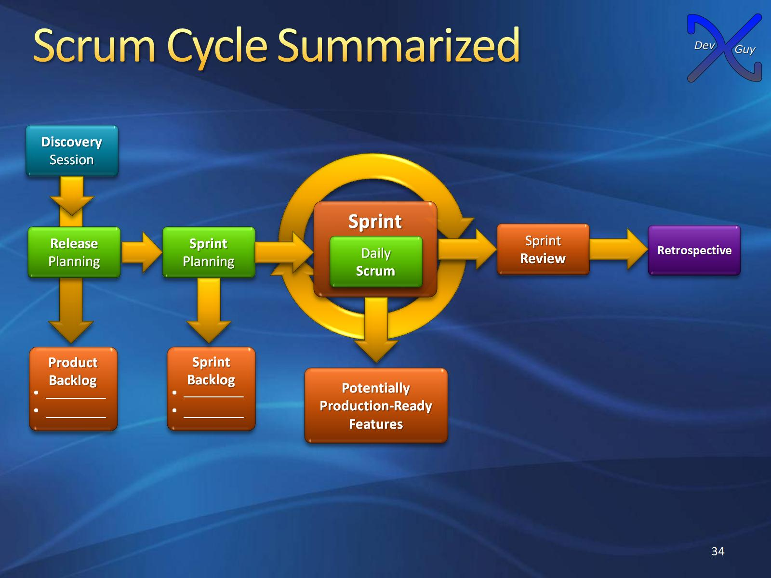
Scrum Cycle Summarized

Slide 35

Agile

Slide 36
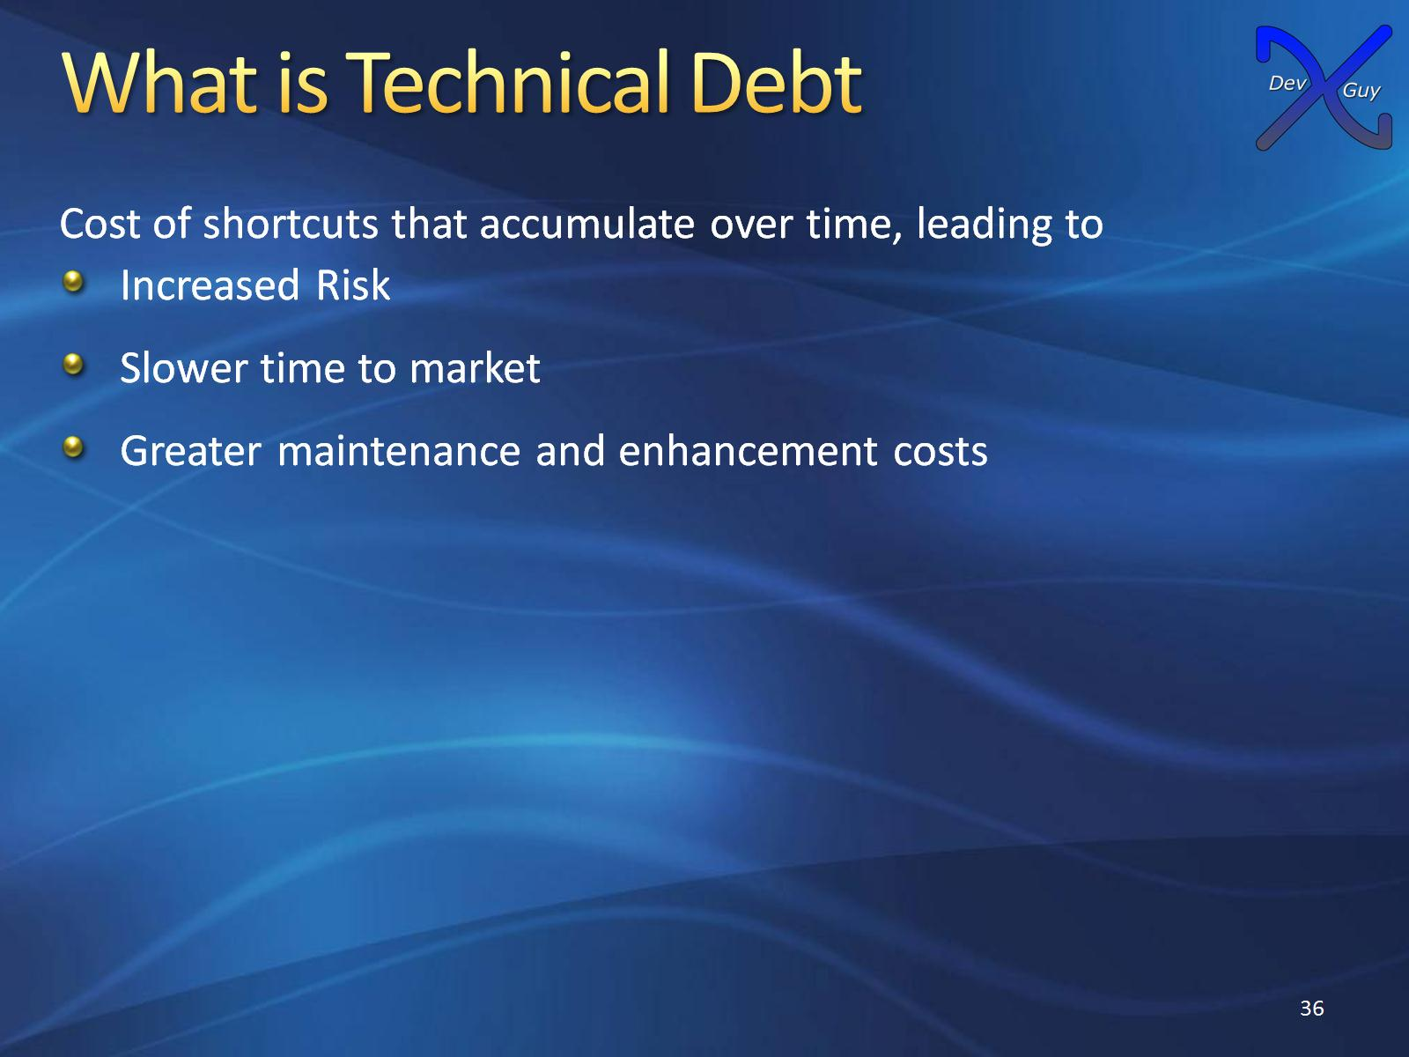
What is Technical Debt

Slide 37
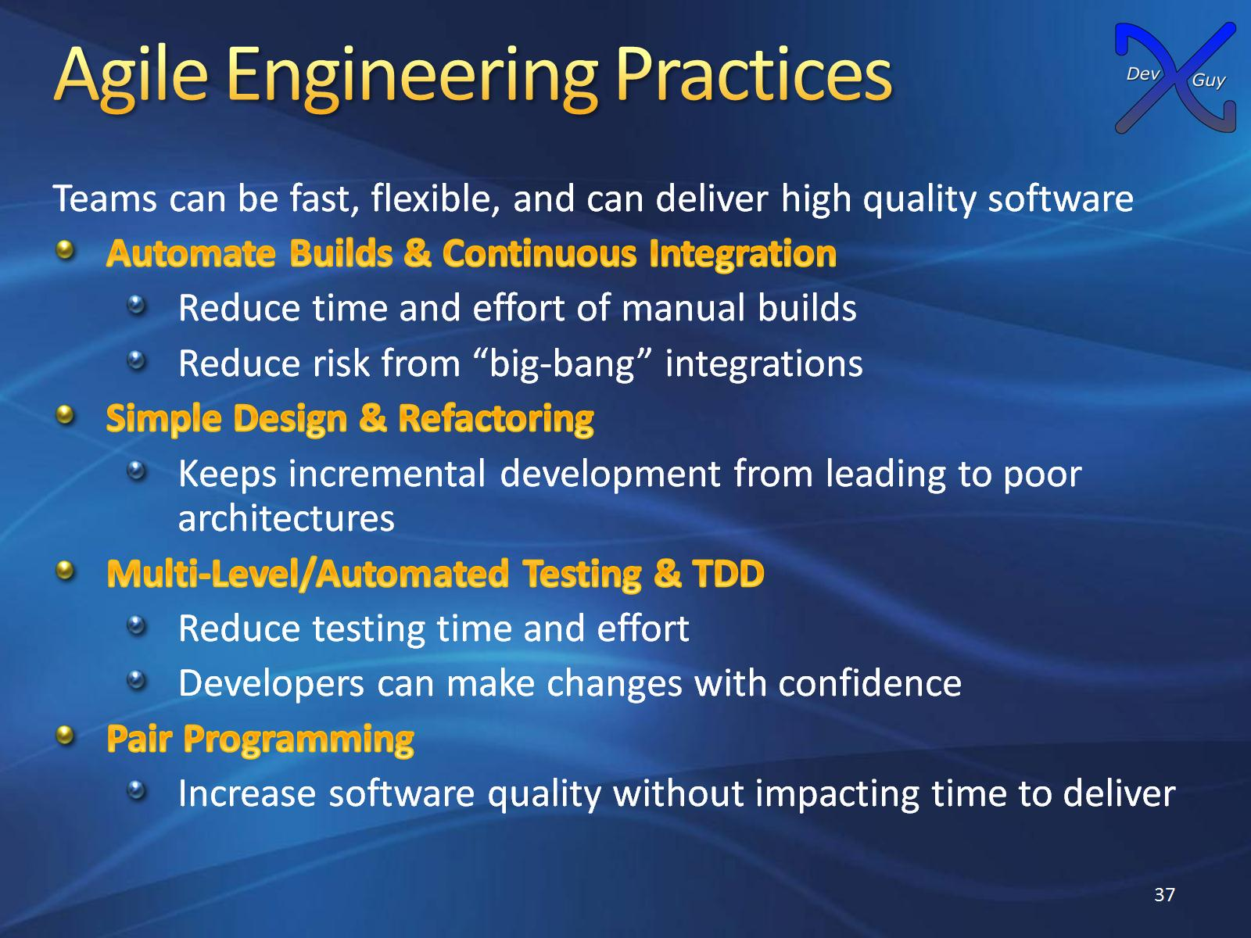
Agile Engineering Practices

Slide 38
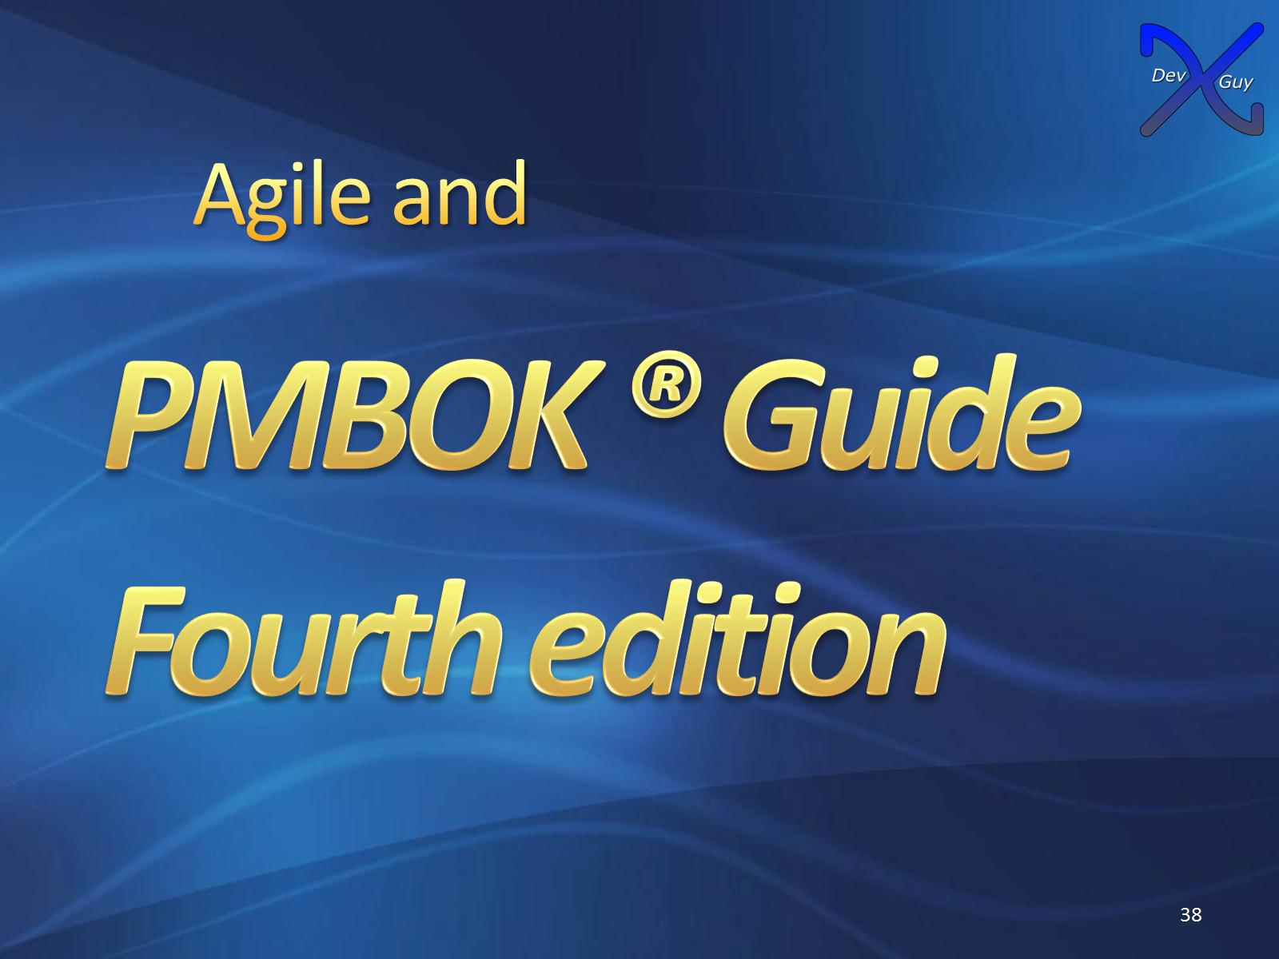
Agile and

Slide 39
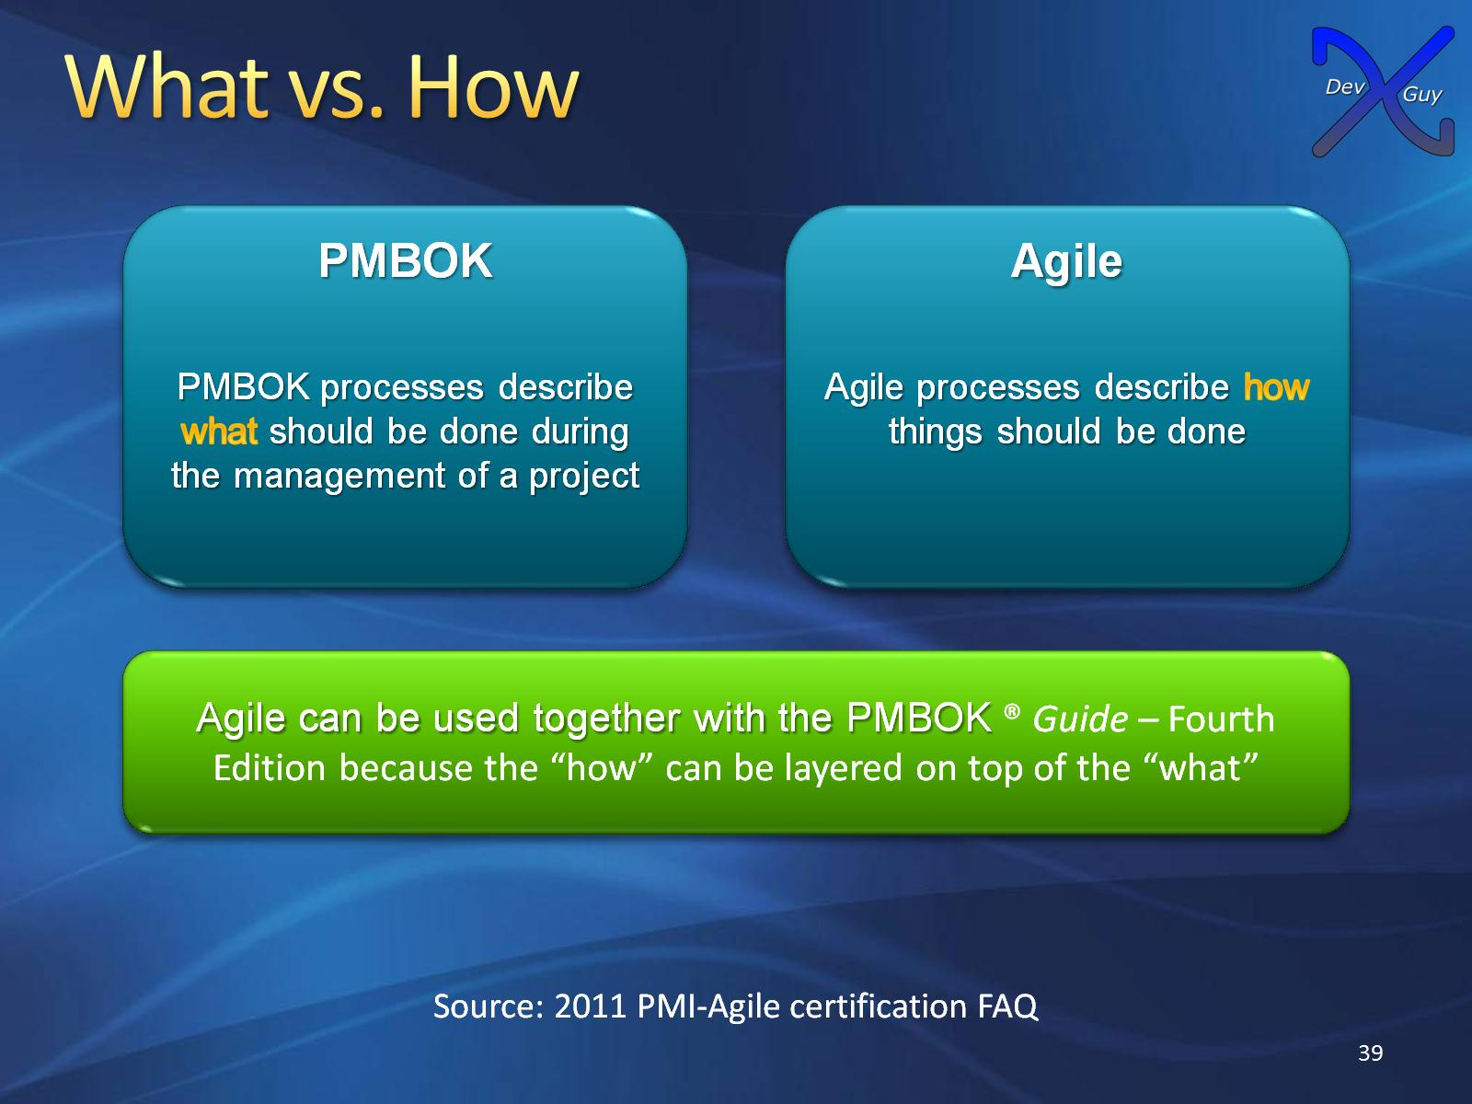
What vs. How

Slide 40
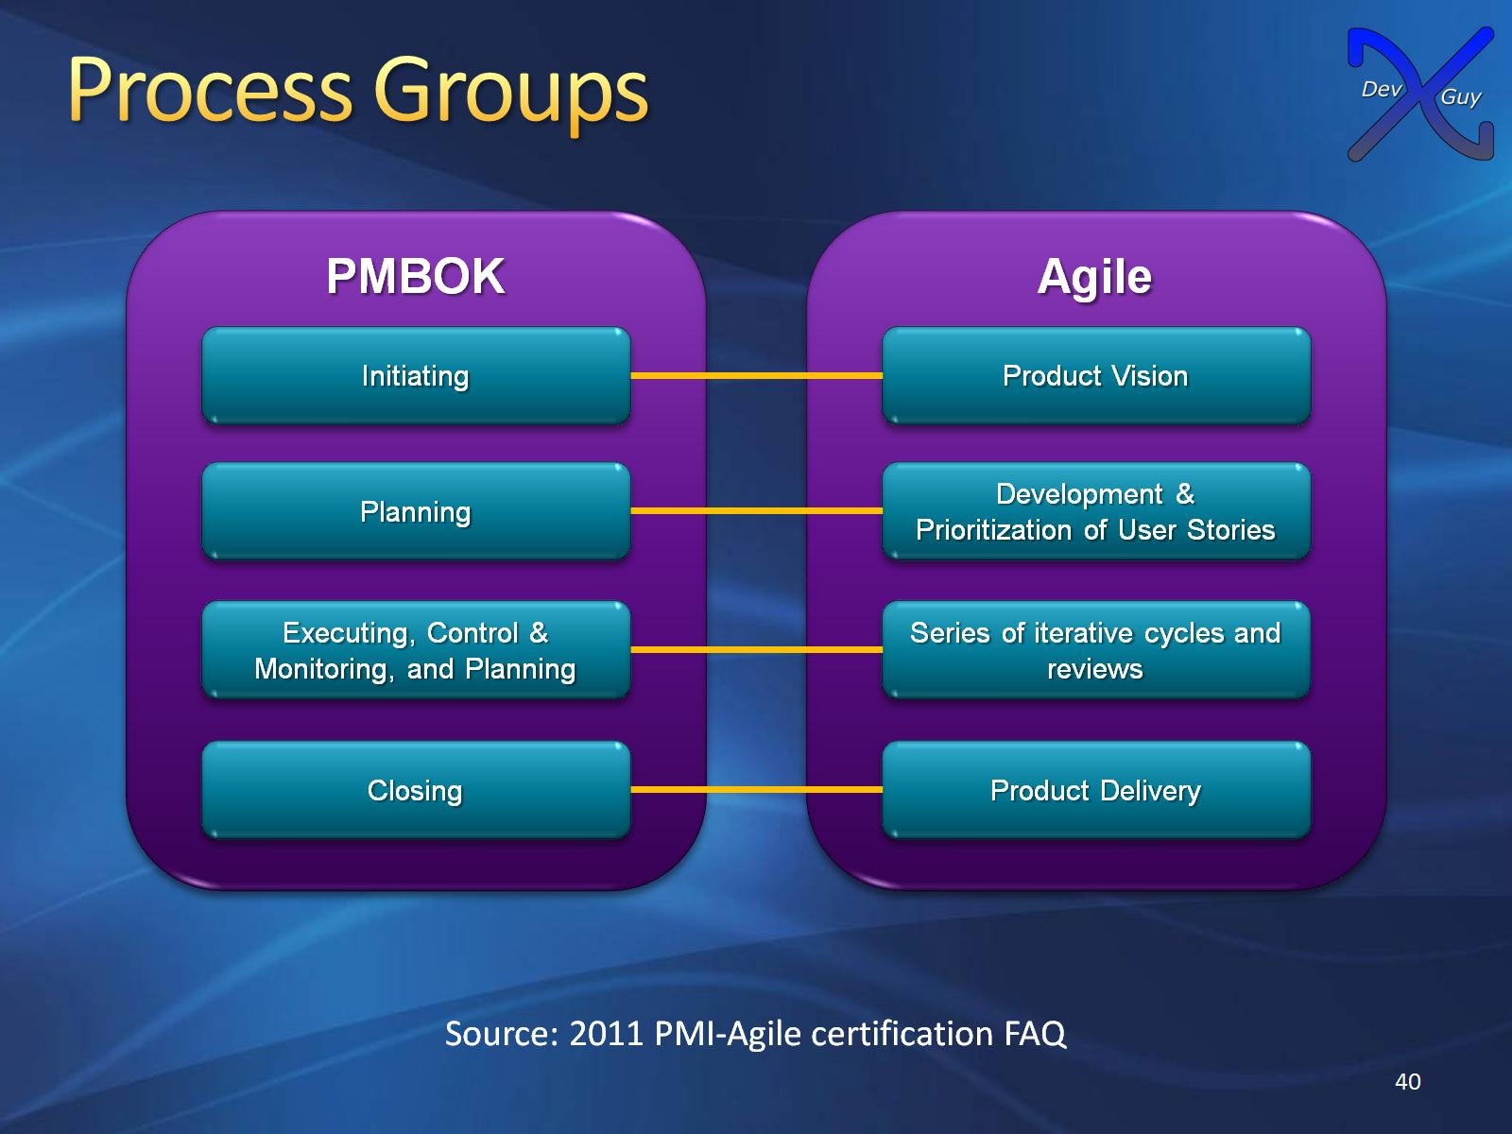
Process Groups

Slide 41

PMI-ACP

Slide 42
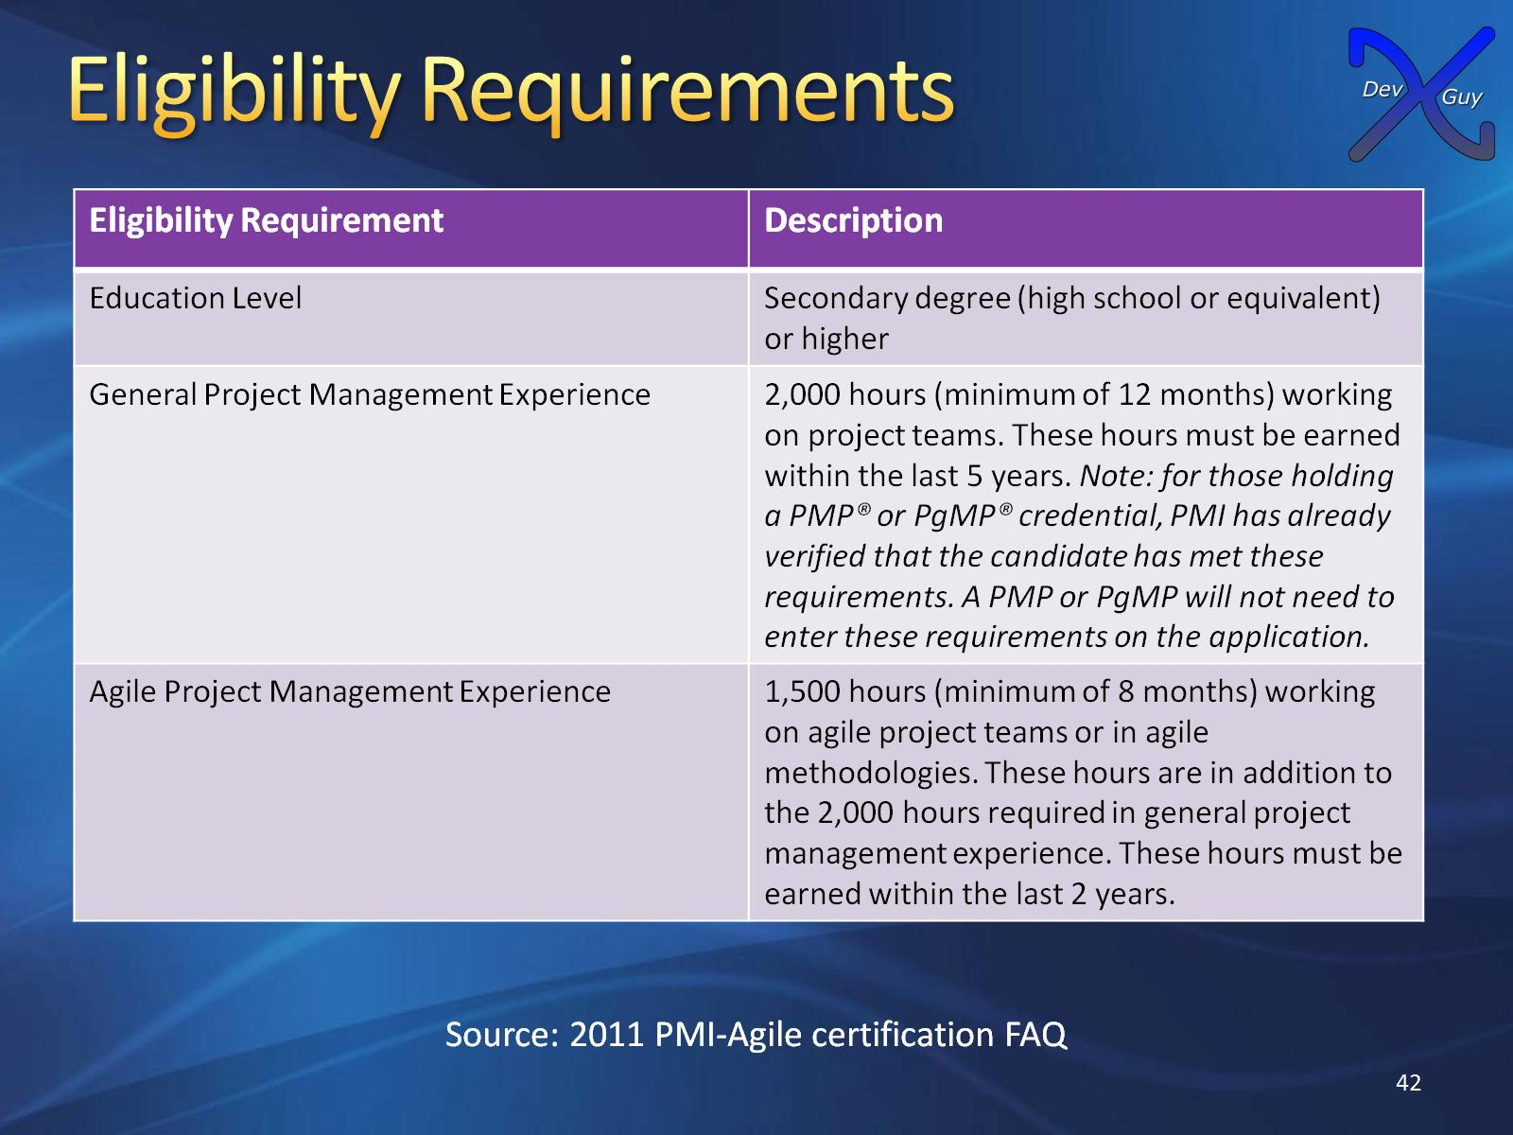
Eligibility Requirements

Slide 43
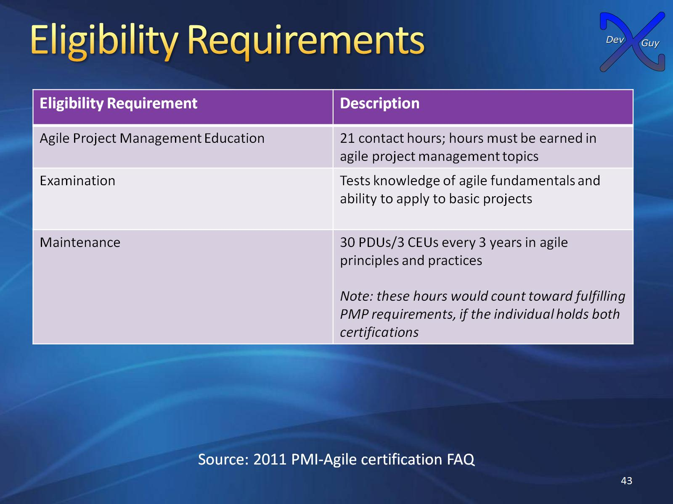
Eligibility Requirements

Slide 44

Thank you

