Slide 1
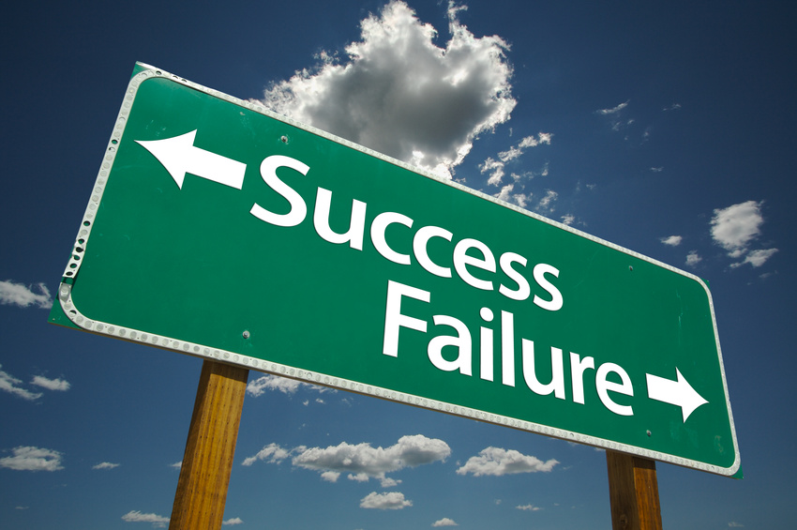
Strategic Planning
The Difference Between Success and Failure

Slide 2
Steps in Strategic Planning
Describe the Current State
Describe the Desired State
Develop Strategies
Measure Performance

Slide 3
Describe the Current State
SWOT Analysis
S
W
Internal
O
T
External
Positive
Negative

Slide 4
Describe the Desired State
Visioning Process
What trends are changing the needs of our organization?
What are others doing that is innovative?
What is one thing that could drastically improve things?
Where do we want to be three years from now? Five?

Slide 5
Develop Strategies
Balanced Scorecard
Customer
What are our customer and stakeholder objectives with respect to meeting our mission and vision?
Financial
What are the financial objectives ?
Internal Processes
At what processes must we excel to be cost efficient and satisfy customer needs?
Learning & Growth
What must we do to develop our internal resources in order to excel at our processess?

Slide 6
Measure Performance
Include both output and outcome measures
Define what data will be used to determine the measure

Slide 7
Tallahassee PMI
Your turn…
S
W
O
T

