Slide 1


Project
Management
Institute
Tallahassee Chapter
Chapter Meeting
August 2, 2021

Slide 2

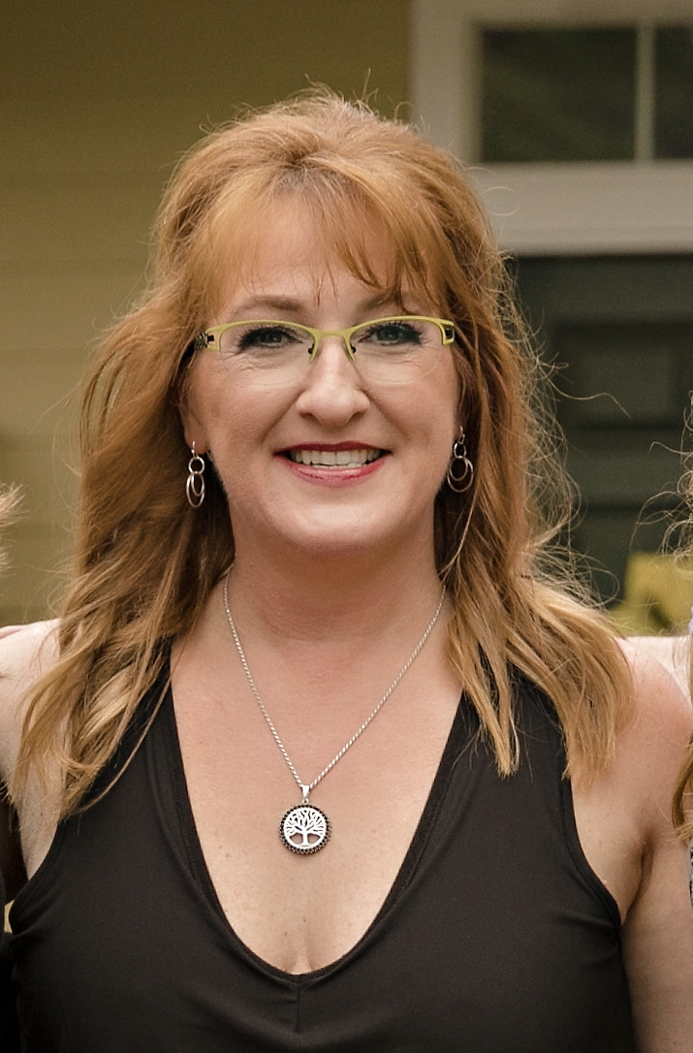
President’s Opening
Remarks
Karen Scott, MBA, PMP

Slide 3
Thanks to those who joined the Emerald Coast / Tallahassee Project Management Symposium July 31, 2021!
Special thanks to our Board members who were speakers: Joanne Gallagher & Becky Green!
More Training Opportunities
We have found an PMI Authorized Training Provider. We will be planning PMP & other PMI training classes soon!

Slide 4

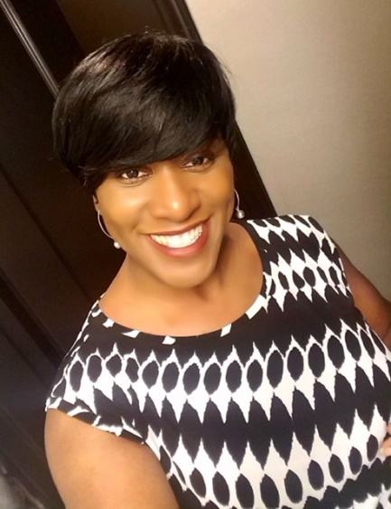
BrainFit:
Are you ready to work out the most
important muscle in your body?
If you are ready to flex, stretch, and strengthen your mind,
then participate in tis series on the importance of exercise, food, meditation, and other necessities to keep your brain vibrant.
BrainFit Round 2 - August 4th
11:15am – 12:15pm via GoTo Meeting
Six Pillars of Brain Health (Pillars 3-4 )
BrainFit Round 3 - August 18th
11:15am – 12:15pm via GoTo Meeting
Six Pillars of Brain Health (Pillars 5 -6)
Wednesday
Felina Martin, Executive Director
Institute for Nonprofit Innovation and Excellence (INIE)
Register at www.pmitlh.org.

Slide 5

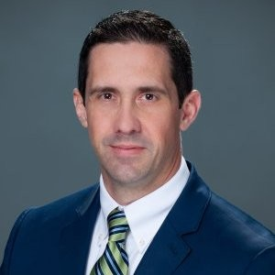
New
Vice President, Membership
Jason Colson has been appointed by the board to fulfill the VP of Membership position.
VPMemb@pmitlh.org
Jason Colson, MBA, PMP, ITILv4

Slide 6

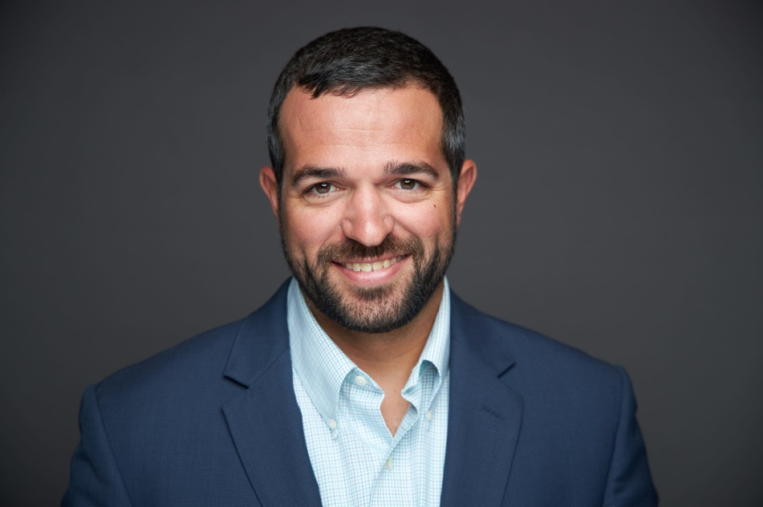

Resumes, Digital Resumes,
and Social Media
by Kevin Berry, TekSystems
PMITLH October Chapter Meeting Event
October 4, 2021
Fingers crossed…we will be in-person.

Slide 7





Stay connected: PMI TLH Social Media Sites
https://www.facebook.com/pmi.Tallahassee
https://www.linkedin.com/company/16227065/
https://www.instagram.com/pmitlhchapter/
http://www.pmitlh.org

Slide 8



  PMITLH Board Elections!
Opportunity to learn, grow, and help the chapter.
Nominations open tonight via survey.
The following Board positions will be on the ballot. These positions require candidates with PMP or higher credential:
  First Vice President
1 year term begins January 1, 2022
Followed by 2-year term as President (2023-2024) and 1-year term as Past President (2025)
Additional Requirement: Previous Board position in another Vice President capacity

Slide 9
  PMITLH Board Elections!
  Vice President Administration
2-year term
January 1, 2022 to December 31, 2023
Responsible for handling the various administrative activities of the chapter, Board meetings, strategic planning, etc.
  Vice President Programs
2-year term
January 1, 2022 to December 31, 2023
Responsible for working with a committee to plan and coordinate the chapter meetings, programs, speakers, venue logistics, etc.

Slide 10
  PMITLH Board Elections!
  Vice President Communications
2-year term
January 1, 2022 to December 31, 2023
Responsible for working with a committee to plan and implement chapter communications, manage the chapter website and social media channels, etc.

Slide 11

  PMITLH Board Elections!
Online candidate submission form (log in to pmitlh.org, look under “Links”).
Nominations will close
mid-September.
Online elections will be held in October after our Oct. 4 chapter meeting.

Slide 12

  PMITLH 2022 Strategic Planning
It’s your chapter!
We want your ideas for our future!
PMITLH will host a lunchtime virtual meeting to gather member feedback on where you want your chapter to go in the future.
Date is TBA – Check pmitlh.org and your email for more details!

Slide 13





  Open Volunteer
  & Committee
  Positions
  Marketing
  Membership
  Communication
  Professional Development

Slide 14
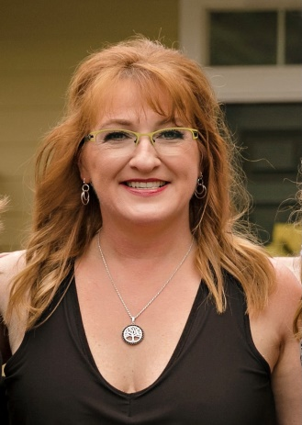
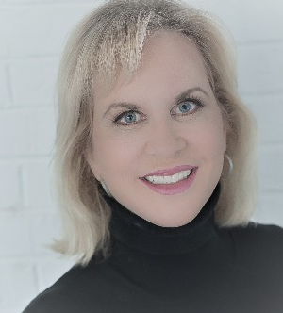
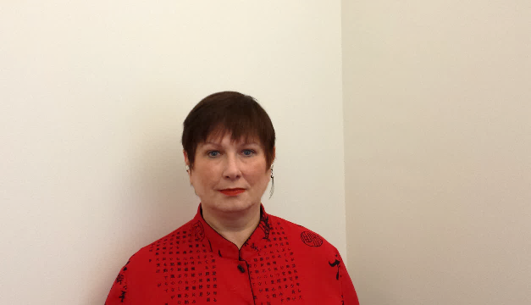
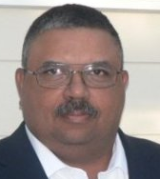

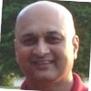
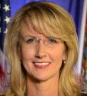
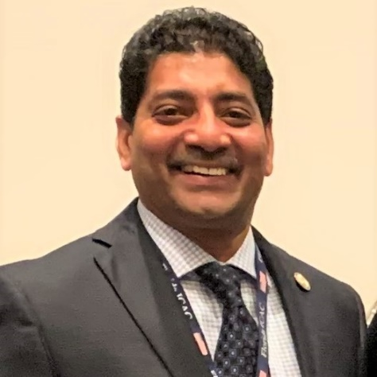
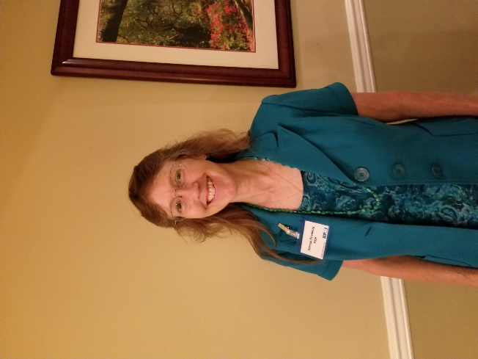
VP – Professional Development
Joanne Gallagher
VP – Programs
Lisa Hopkins
President
Karen Scott
Your 2021 Board
Past President
David Davis
VP – Membership
Jason Colson
VP – Finance
Amit Bokey
VP – Administration
Debbie Rivenburg
Director of Volunteers
Shajil K Kalathil
VP – Communications
Rebecca Green

Slide 15
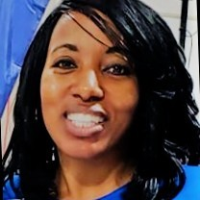



  Guest Speaker: Kim Moore
“Networking: The Power of Connecting the Dots”
Imagine walking into a room and realizing that you don’t know any one and the anxiety sets in of what to do next or better yet you walk into a room and you know a few people and you automatically gravitate to who you know…..without ever meeting anyone else in the room. Does this sound like you? Perhaps you may even have these same thoughts about social media platforms and establishing an online presence and the benefits of going down any of these paths. Well, it’s not too late to figure out what all the fuss is about to create social capital or why you’ll want to take on the challenge to make each room (in-person or virtual) an opportunity to increase your network and expand your opportunities. To get started, join me on August 2nd and together we’ll create an action plan for building your network and goals to keep you on target.
Notes:
Kimberly Moore has spent over a decade in the workforce development arena. She currently serves as the Vice President for Workforce Innovation at Tallahassee Community College (TCC). In the position of Vice President, she is responsible for developing strategic solutions that address the needs of employers and those seeking to enter or advance in the workforce. Prior to joining TCC, she served as the Chief Executive Officer of WORKFORCE plus, the regional economic and workforce development body.
Ms. Moore is a 1993 graduate of Tallahassee Community College with an Associate of Arts degree. She continued her education at The Florida State University, earning a Bachelor of Science degree in Criminal Justice in 1995. In May 2006, she earned her M.B.A from Webster University. She is a proud member of Leadership Tallahassee Class 24 and Leadership Florida Class 33.
In addition to her role at TCC, she continues to give back to her community through service. Note a few of Ms. Moore’s many volunteer roles include serving as Chair- Leon County Research Development Authority, Vice-Chair of Florida A&M University Board of Trustees, Vice-Chair of the Economic Vitality Leadership Council, Truist/SunTrust Community Advisory Board and Board of Director for the Greater Tallahassee Chamber of Commerce and Wakulla Chamber of Commerce. She has been recognized locally, statewide and nationally for her service and commitment to excellence with accolades including: Tallahassee’s Top 26 Women in Business (2007), the Greater Tallahassee Chamber of Commerce Distinguished Leadership Pacesetter Award (2009), the Dr. Reginald Rolle Memorial Economic Development Champion of the Year Award (2010), Florida Diversity Council’s 2014 Florida’s Most Powerful and Influential Woman Award, Tallahassee Woman Magazine’s 2016 ‘Women Who Mean Business’ Innovator of the Year Award , 2017 inductee to the Tallahassee Community College’s Hall of Fame, 2019 Economic Innovator of the Year, Florida State University - Omicron Delta Kappa (Honoris Causa) - 2020 and 2021 Idahlynn Karre Exemplary Leadership Award.

Slide 16

PDU Claim Code:
C287T2GAJC
We’ll open it up for questions after Kim’s presentation.
Don’t forget to complete the survey & make nominations for upcoming Board positions!

