Slide 1
Maintaining Muscle with Age
By
Christopher M. Schattinger, Ph.D. Candidate

Slide 2
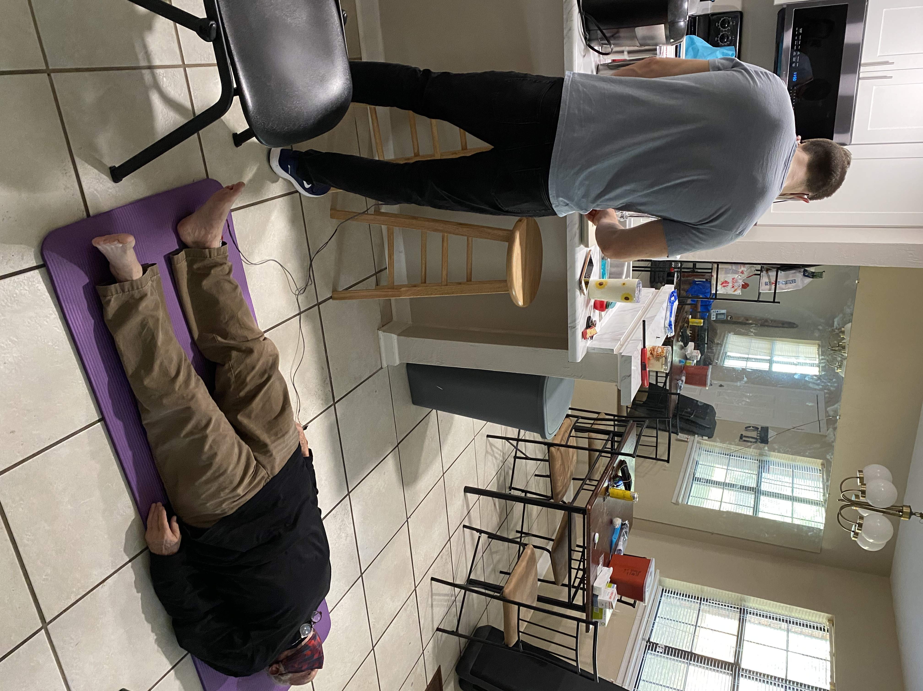
A little about me….

Slide 3
We all get older, like it or not.
United Nations, 2010

Slide 4
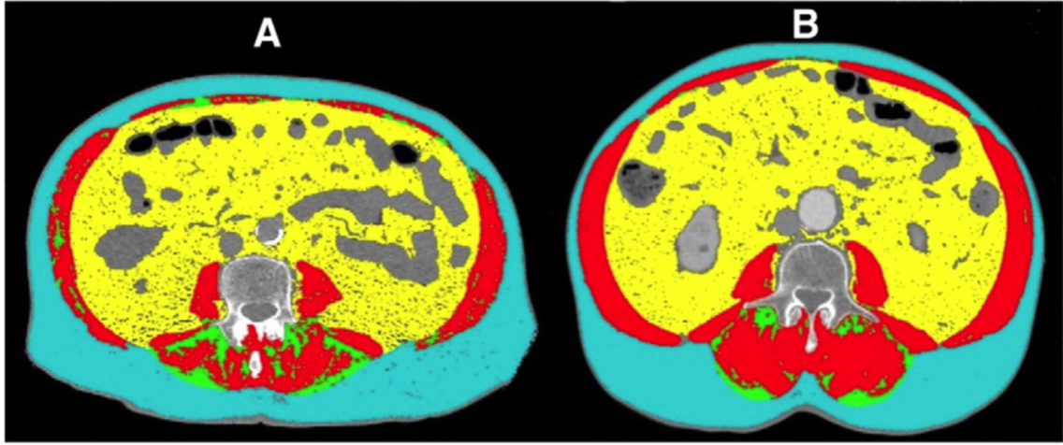
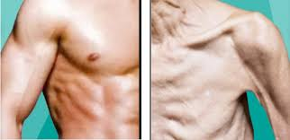
Age = Age-related disease
Sarcopenia
“Loss of muscle tissue as a natural part of the aging process.”

Slide 5
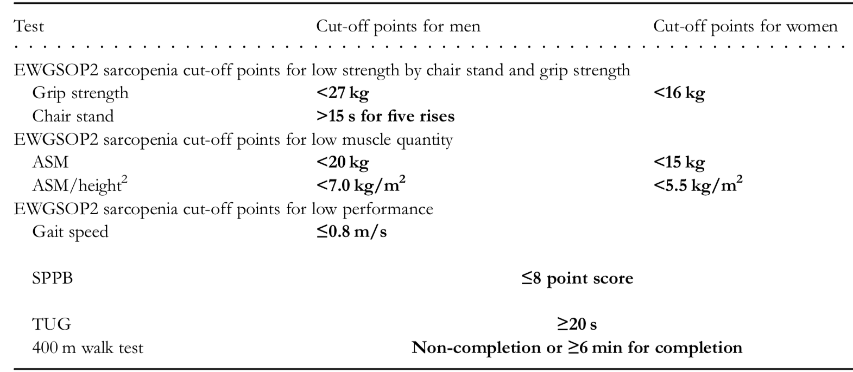
Diagnoses
Cruz-Jentoft et al., 2019

Slide 6
So, what’s the big deal?
Sarcopenia is associated with increased risk of falls, fractures, and mortality.
Sarcopenia raises risk for negative health outcomes by causing an age-related decline in muscle mass and strength.
Sayer et al., 2013
Morley et al., 2013
Delmonico et al., 2007
Cao et al., 2016

Slide 7
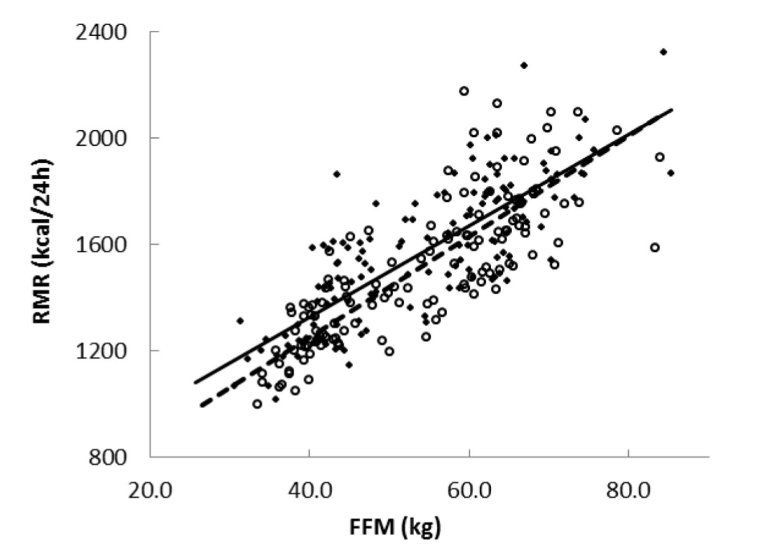

Slide 8
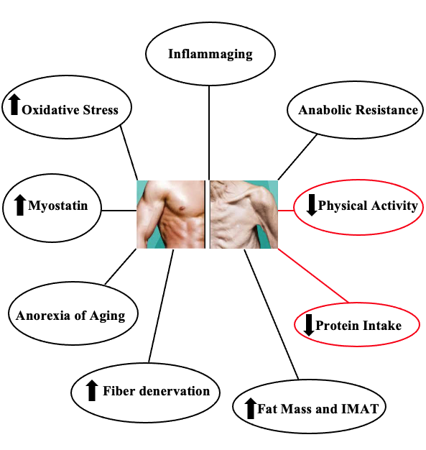
Why does it happen?

Slide 9
Decline in Physical Activity
Both frequency and intensity of physical activity are found to decline with age.
Some evidence suggests 1/3 of adults over 50 are sedentary and when exercise does occur it is of low intensity.
Even minor behavioral modifications such as step count reduction have been shown to be detrimental.
Watson et al., 2016
Troiano et al.,2008
Breen et al., 2013
Devries et al., 2015

Slide 10
Decline in Protein Intake
32–41% of women and 22–38% of men older than 50 years consume less than the RDA for protein (0.8 g/kg/d).
RDA appears to be inadequate, and some recommend 1.0-2.0 g/kg/d.
RDA 1.2 g/kg/d may be the minimum.
Bowman et al., 2013
Deutz et al., 2014
Traylor et al., 2018
Wolfe et al., 2008
Humayun et al., 2007
Rafii et al., 2014

Slide 11
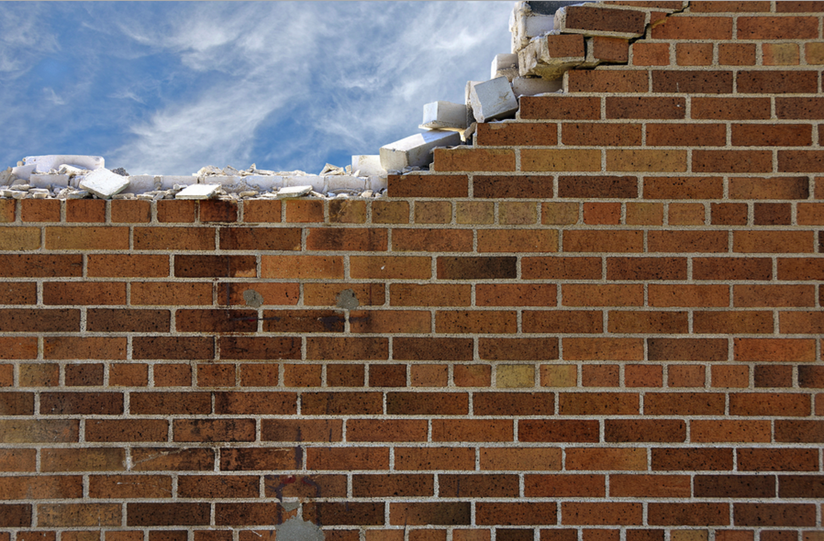
Muscle Protein Balance
Net Balance: Difference between muscle protein synthesis (MPS) and muscle protein breakdown (MPB).
MPS > MPB = + Net Balance
MPS < MPB = - Net Balance

Slide 12
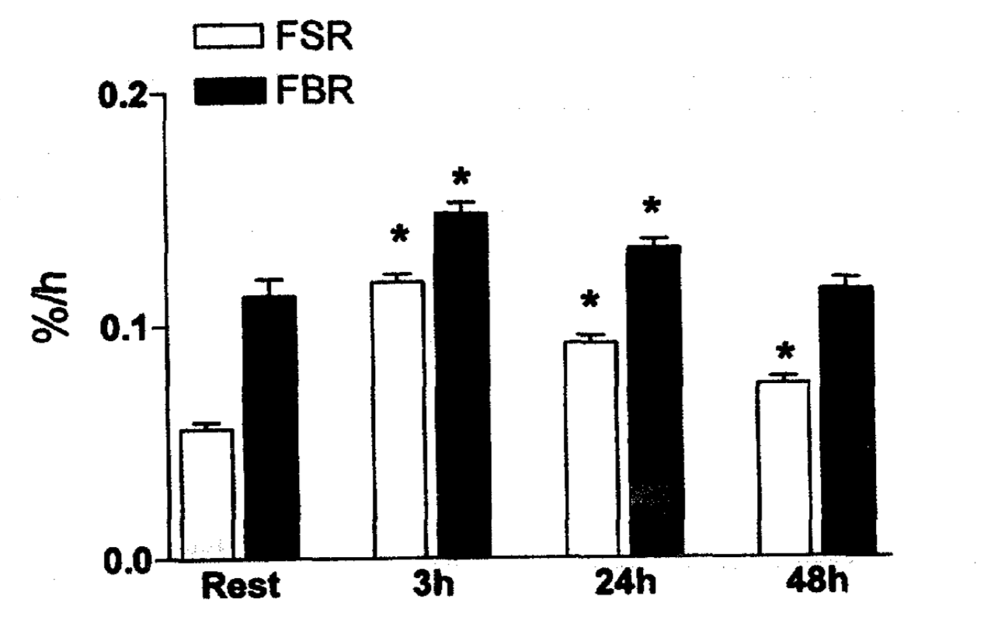
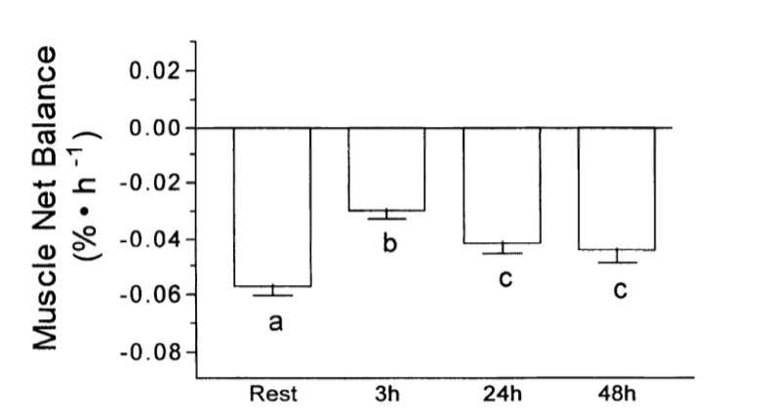
Bringing it all together
Tipton et al., 2001
Phillips et al., 1997

Slide 13
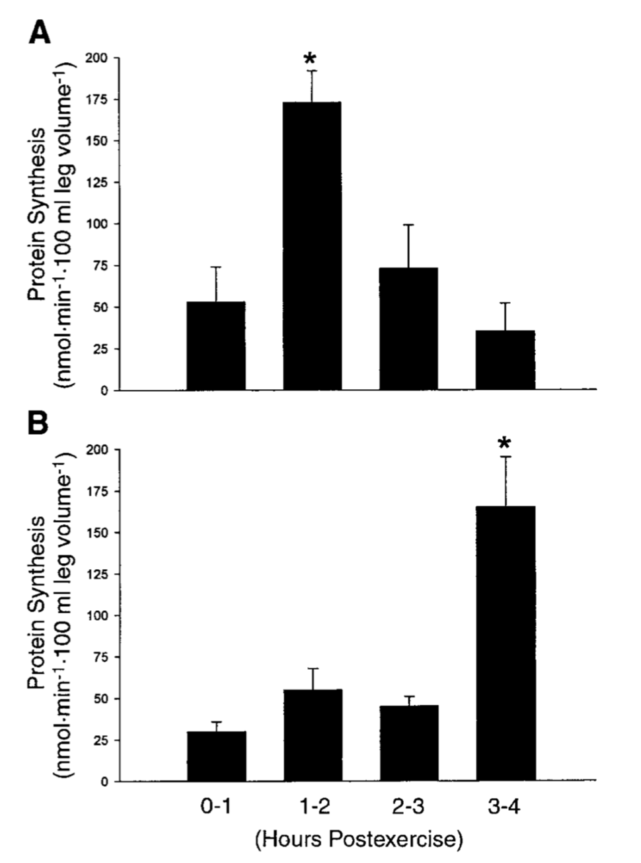
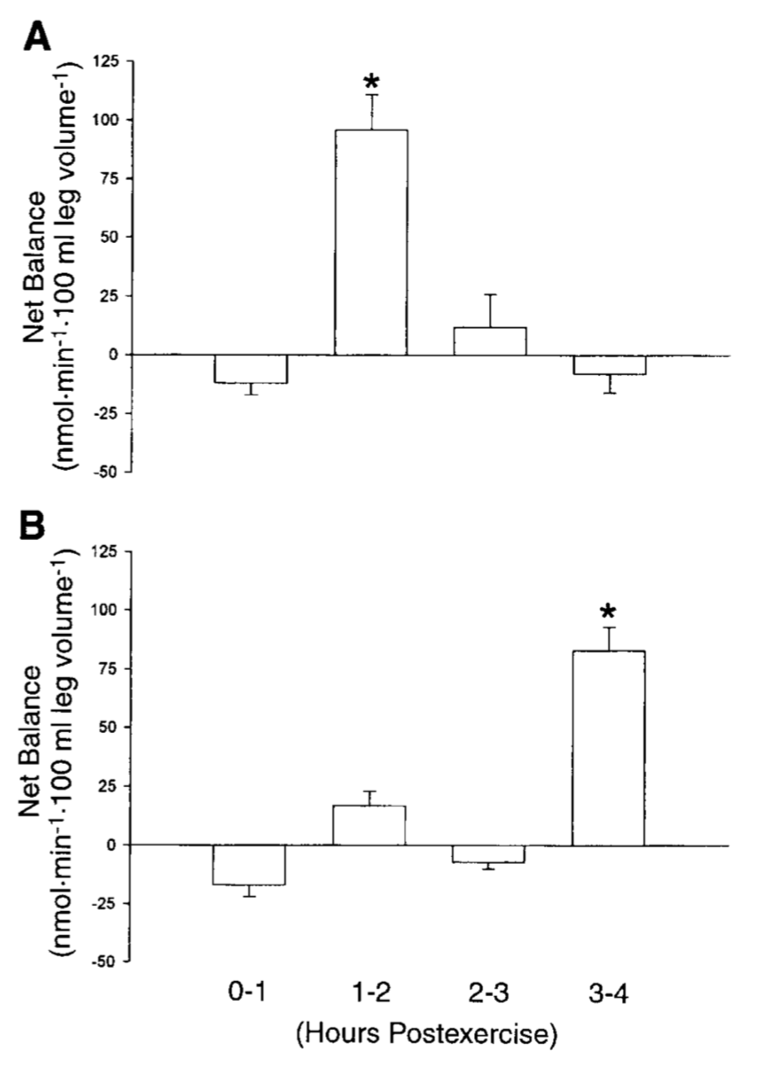
Rasmussen et al., 2000

Slide 14

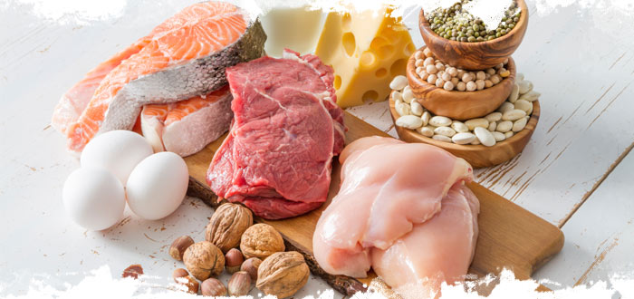
So, what can you do?
+

Slide 15
Resistance Training Guidelines
ACSM recommends strength training be performed a minimum of 2 nonconsecutive days per week.
One set of 8-12 repetitions.
8-12 exercises that target the major muscle groups.

Slide 16
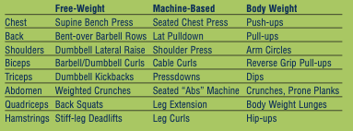

Slide 17
Frequency
Novice individuals: 2 - 3 days per week (full body).
Intermediate individuals: 3 days per week (full body) or 4 days per week if using an upper/lower body split routine.
Advanced individuals: 4 - 6 days per week training each major muscle group once to twice per week.
Esco 2013

Slide 18
Training for Muscle Growth
Load: 60-70% 1RM for novice to intermediate; 70-100% for advanced.
Volume: 1-3 sets of 8-12 repetitions for novice to intermediate; 3-6 sets of 1-12 repetitions for advanced.
Rest period: 1-3 minutes.
Esco 2013

Slide 19
Training to Gain Strength
Load: 70-85% 1RM for novice to intermediate; 80-100% for advanced.
Volume: 1-3 sets of 8-12 repetitions for novice to intermediate; 2-6 sets of 1-8 repetitions for advanced.
Rest period: 1-3 minutes.
Esco 2013

Slide 20
Eat More Protein!
The current RDA for protein (0.8 g/kg/d) is inadequate for the maintenance of muscle mass, let alone gaining muscle.
Anywhere from a 0.24-0.4 g/kg dose depending on age. This translates to anywhere from a 20 to 35 g dose.
Try for at least 1.2 g/kg/d.
35% of calories from protein is AMDR for older adults.
Katsanos et al., 2006
Houston et al., 2008
Bowman et al., 2013

Slide 21
To Conclude
”Credentials are irrelevant if the evidence is on your side.”
-Jay Bhattacharya, M.D., Ph.D.

