Slide 1


Project
Management
Institute
Tallahassee

Slide 2


Slide 3


Open Volunteer & Committee Positions
Director of Volunteers
Marketing Skills
Membership Committee
Communication Committee
Professional Development Committee

Slide 4






2020 Elections
Vice President of Finance
Vice President of Membership
Vice President of Professional Development

Slide 5
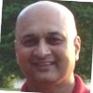
Nominee for VP of Finance
Amit Bokey
(Incumbent)
I have served the PMITLH chapter as a volunteer of the Finance committee for past few years and had been recently appointed to serve as VP Finance. It is my goal to continue to serve PMITLH chapter and continue to support the organization in my capacity as VP Finance.

Slide 6
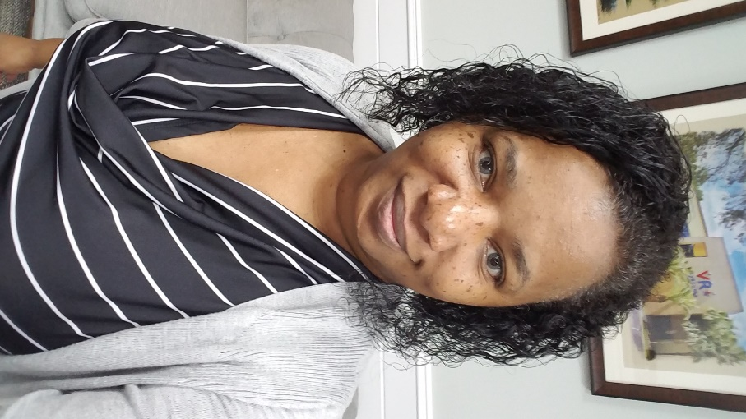
Nominee for VP of Membership
Tamara Davis
(Current VP Professional Development)
I believe that I will be able to contribute more to membership and already have some ideas that could help boost membership.

Slide 7
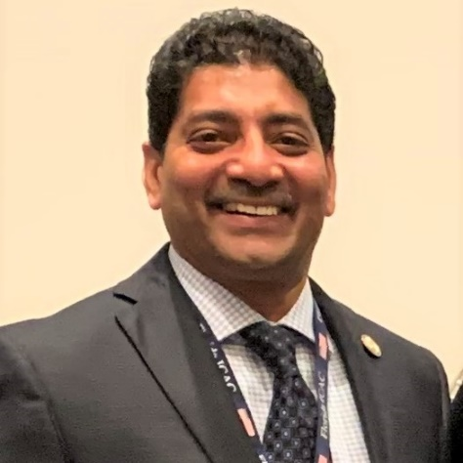
Nominee for VP of Membership & VP Professional Development
Shajil K Kalathil
To help my local chapter has always been my dream. I am now working locally and will be able to devote my time to help PMITLH grow. I have a good network of people both in the private and public sector that I hope to leverage to grow our local chapter

Slide 8
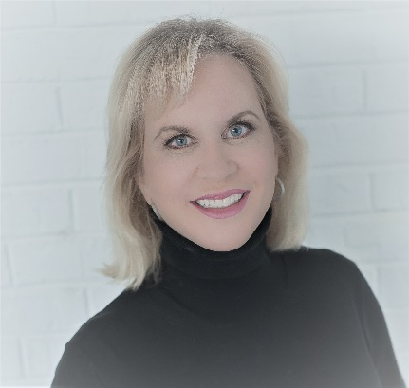
Nominee for VP of Professional Development
Joanne Gallagher
Now that I am not traveling as much as in my old job, I would like to utilize my professional connections and expand on them too as I become part of our Tallahassee PMI community.

Slide 9
I’d like to ask each nominee to take 2 minutes to introduce themselves:
Amit Bokey - Nominee for VP of Finance
Tamara Davis - Nominee for VP of Membership
Joanne Gallagher - Nominee for VP of Professional Development
Shajil K Kalathil - Nominee for VP of Membership and VP of Professional Development

Slide 10


Please don’t forget to take a few minutes to give us feedback about tonight's meeting
https://www.surveymonkey.com/r/ZFRP75P

Slide 11
Project
Management
Institute
Tallahassee

Slide 12

  COVID's Impact on Project Management and Our Local Area

