Slide 1


Project
Management
Institute
Tallahassee

Slide 2


Slide 3

Thanks to our Chapter Members during 2020

Slide 4
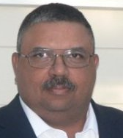
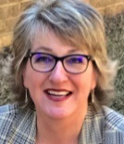
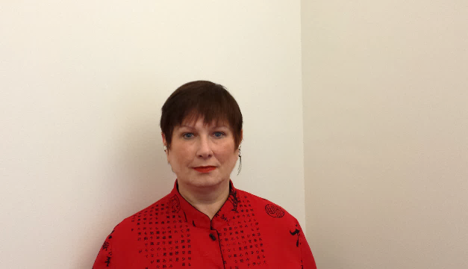
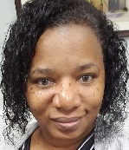
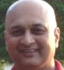
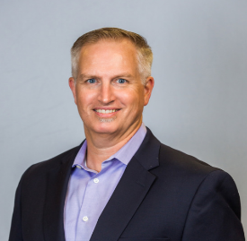
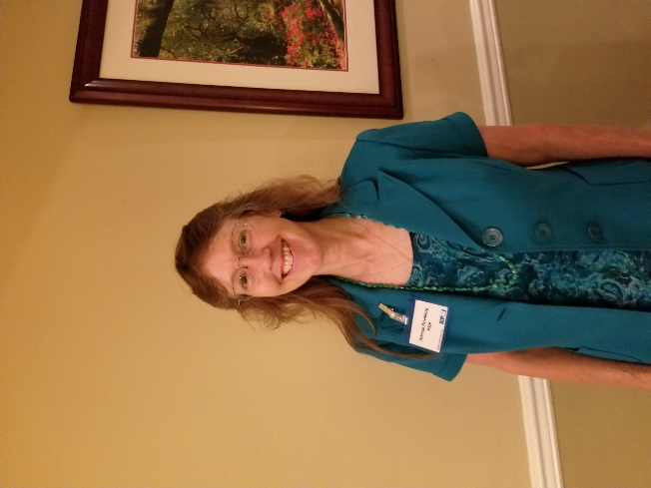
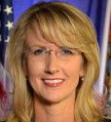
President
David Davis
First VP
Karen Scott
VP – Programs
Lisa Hopkins
VP – Professional Development
Tammy Davis
VP – Finance
Amit Bokey
VP – Membership
Sean Gibbs
VP – Administration
Debbie Rivenburg
VP – Communications
Rebecca Green

Slide 5

Thanks to
PMITLH
Committee
Members

Slide 6
Check out our updated website:
PMITLH.org

Slide 7
PMITLH LinkedIn
https://www.linkedin.com/company/pmi-tallahassee-florida-chapter/

Slide 9
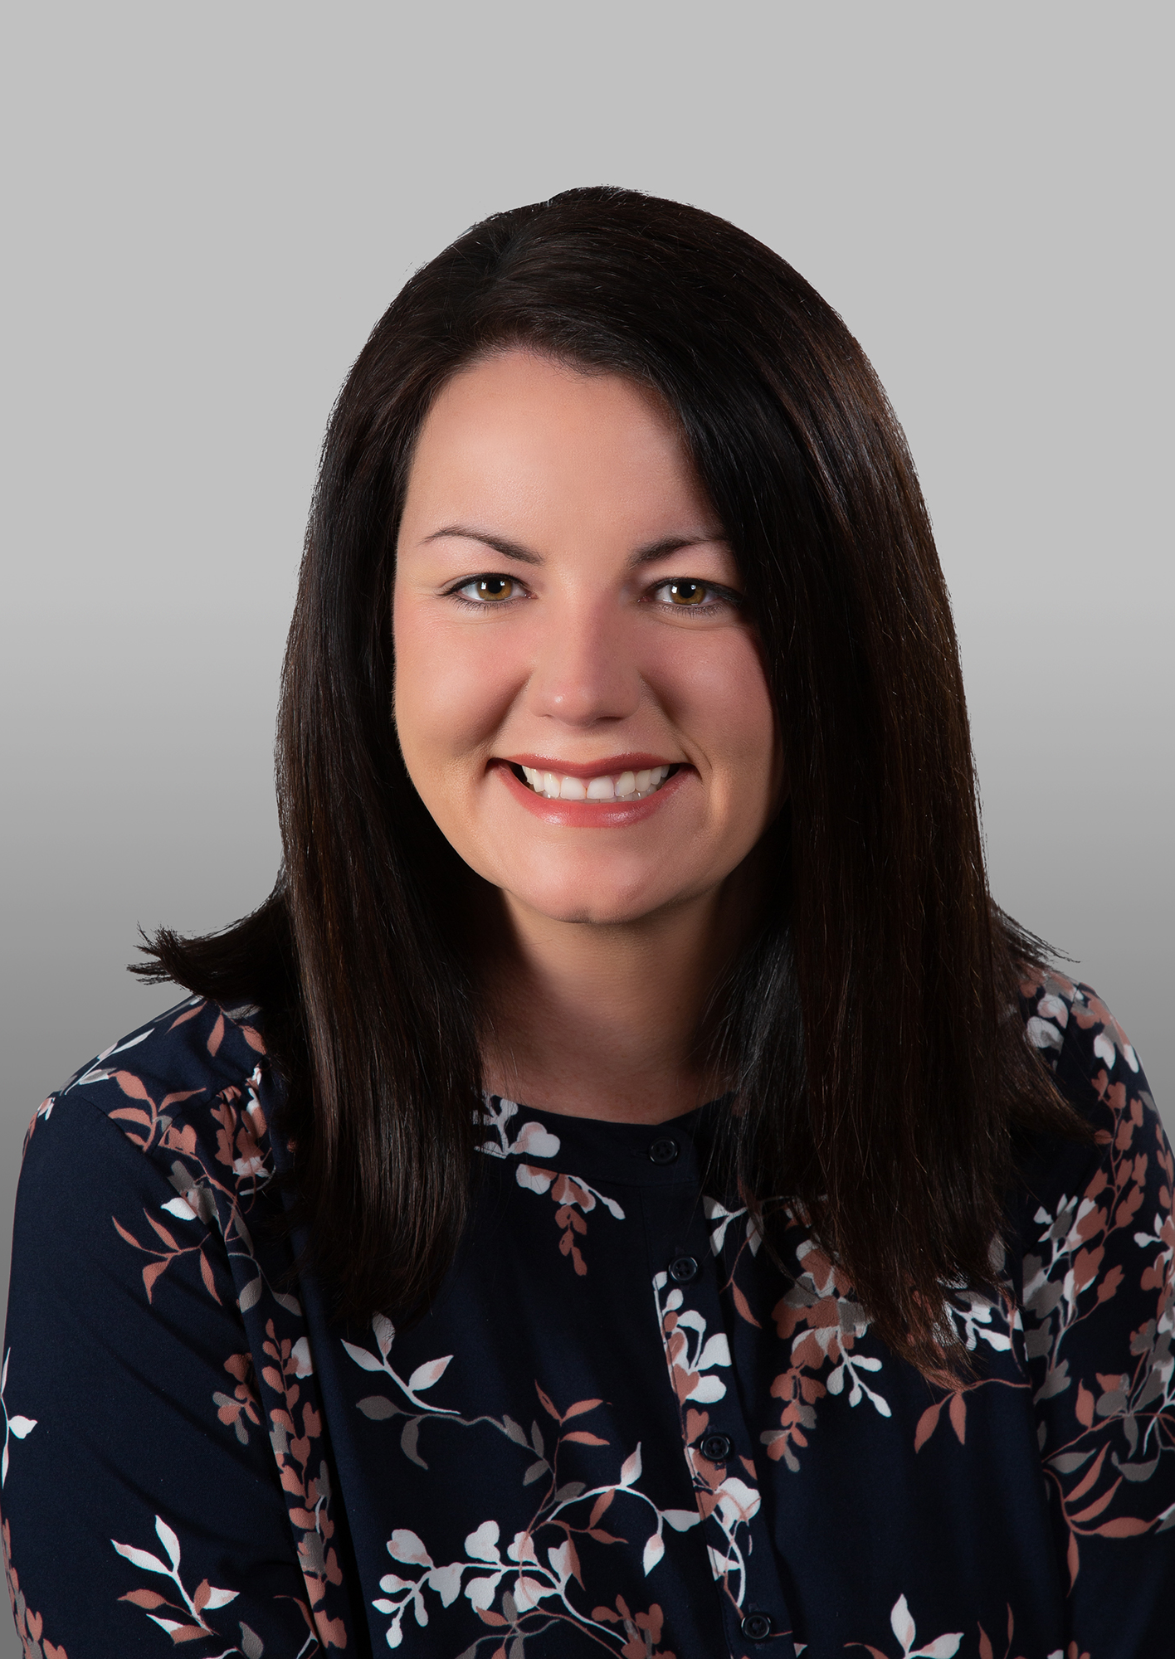




TBD
  Burnout at Work: A Threat to Our Organizations
President of Strategic Empowerment Consulting
Master of Social Work degree from Florida State University with a specific focus in organizational administration and policy.
Over 20 years in the business and nonprofit sectors
Brandy Carlson

